Slide 1
BCS1520: Statistics
Lecture 06:
Probability meets Statistics

Slide 2
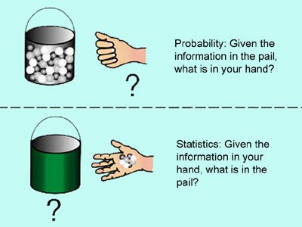
Probability Theory vs Statistics
Picture from: https://www.quora.com/What-is-the-difference-between-probability-and-statistics

Slide 3
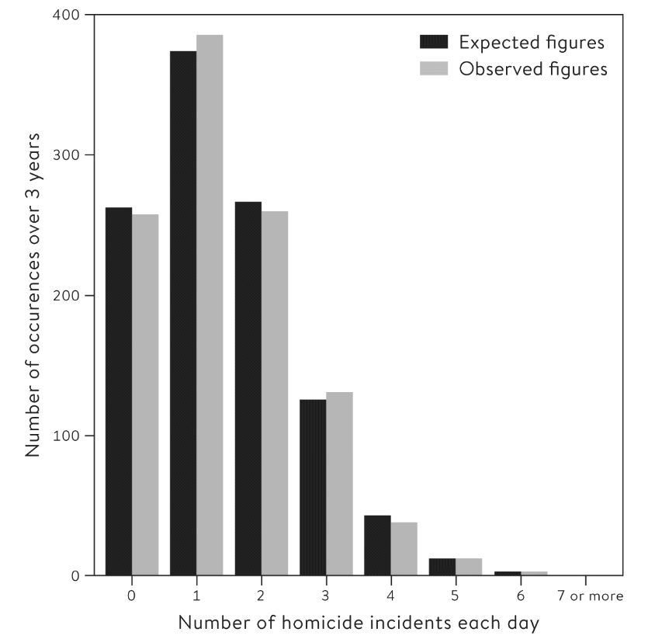
Discrete Random Variables
Thinking about the Poisson distribution for homicide events again.
Every day is considered an independent random variable.
So for each day, we are drawing from the Poisson distribution.

Slide 4
Independent RVs
Every day is considered an independent random variable.
Consistently an assumption when using probability theory to do statistics.
We assume each sample we have is an independent random variable.
OR. We model the non-independence directly.

Slide 5
Discrete Random Variables
So, for each day, we are drawing from the Poisson distribution.
In fact, this fits what is called a Poisson process.

Slide 6


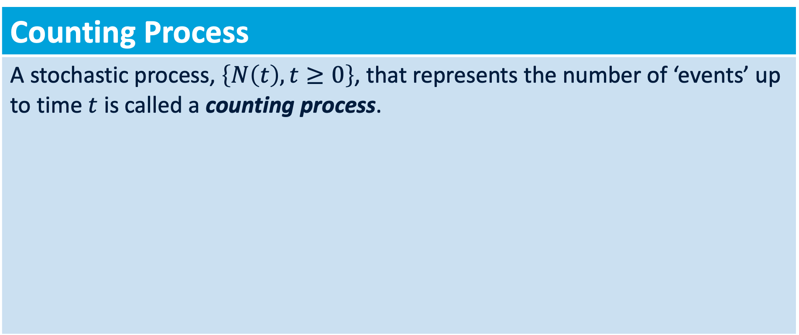
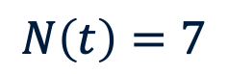

Poisson Process & Distribution
Counting Process
A stochastic process, $\left\{N\left(t\right), t≥0\right\}$, that represents the number of ‘events’ up to time $t$ is called a counting process.
$$0$$
$$t$$
$$N\left(t\right)=7$$

Slide 7

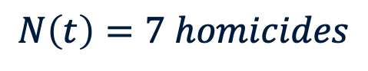
Poisson Process & Distribution
Counting Process
A stochastic process, $\left\{N\left(t\right), t≥0\right\}$, that represents the number of ‘events’ up to time $t$ is called a counting process.
$$0$$
$$1 day$$
$$N\left(t\right)=7 homicides$$

Slide 8
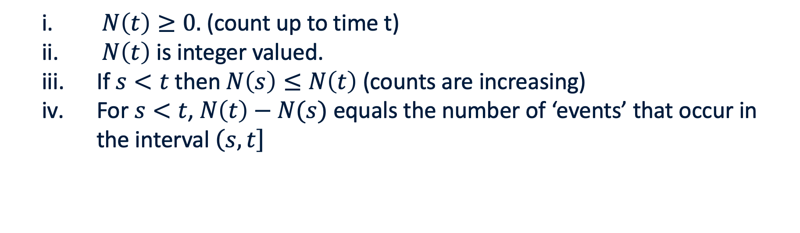

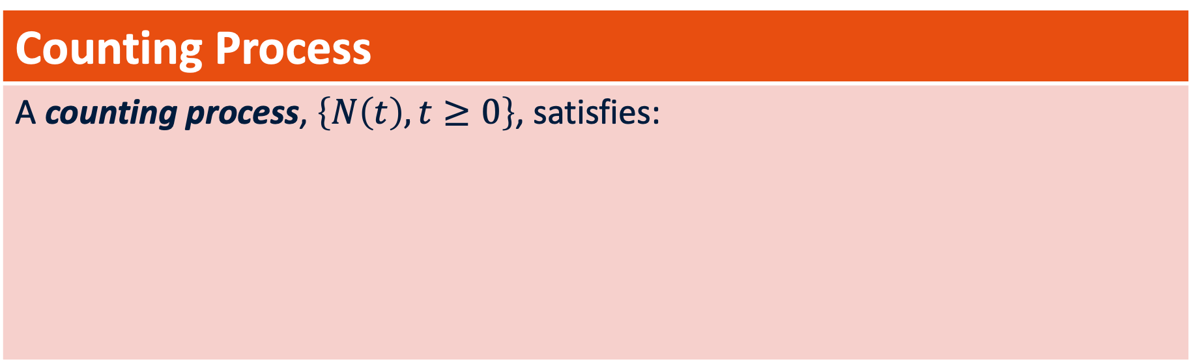
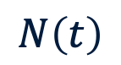


Poisson Process & Distribution
Counting Process
A counting process, $\left\{N\left(t\right), t≥0\right\}$, satisfies:
$N\left(t\right)≥0.$ (count up to time t)
$N\left(t\right)$ is integer valued.
If $s<t$ then $N\left(s\right)≤N\left(t\right)$ (counts are increasing)
For $s<t$, $N\left(t\right)−N(s)$ equals the number of ‘events’ that occur in the interval $\left(\left.s,t\right]\right.$
$$N\left(t\right)$$
$$0$$
$$t$$
$$Days$$

Slide 9
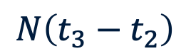

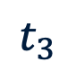

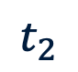
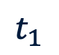
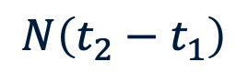
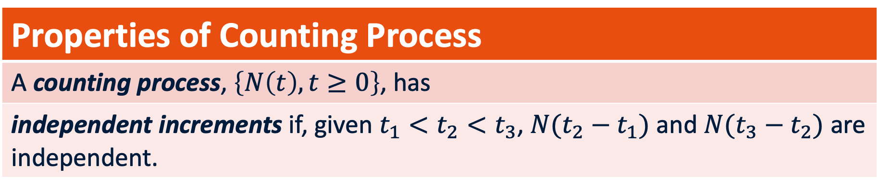
Poisson Process & Distribution
Properties of Counting Process
A counting process, $\left\{N\left(t\right), t≥0\right\}$, has
independent increments if, given $t_{1}<t_{2}<t_{3}$, $N({t_{2}−t}_{1})$ and $N({t_{3}−t}_{2})$ are independent.
$$N\left(t_{2}−t_{1}\right)$$
$$t_{1}$$
$$t_{2}$$
$$t_{3}$$
$$0$$
$$t$$
$$N\left(t_{3}−t_{2}\right)$$

Slide 10


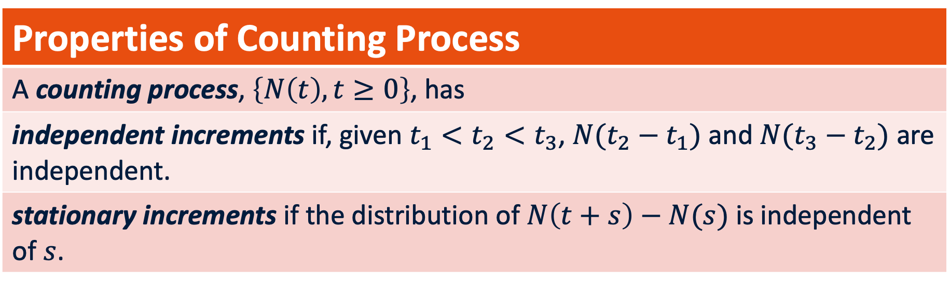



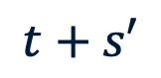
Poisson Process & Distribution
Properties of Counting Process
A counting process, $\left\{N\left(t\right), t≥0\right\}$, has
independent increments if, given $t_{1}<t_{2}<t_{3}$, $N({t_{2}−t}_{1})$ and $N({t_{3}−t}_{2})$ are independent.
stationary increments if the distribution of $N\left(t+s\right)−N(s)$ is independent of $s$.
$$N\left(t+s\right)−N\left(s\right)$$
$$s$$
$$s′$$
$$t+s$$
$$t+s′$$
$$0$$
$$N\left(t+s′\right)−N\left(s′\right)$$

Slide 11
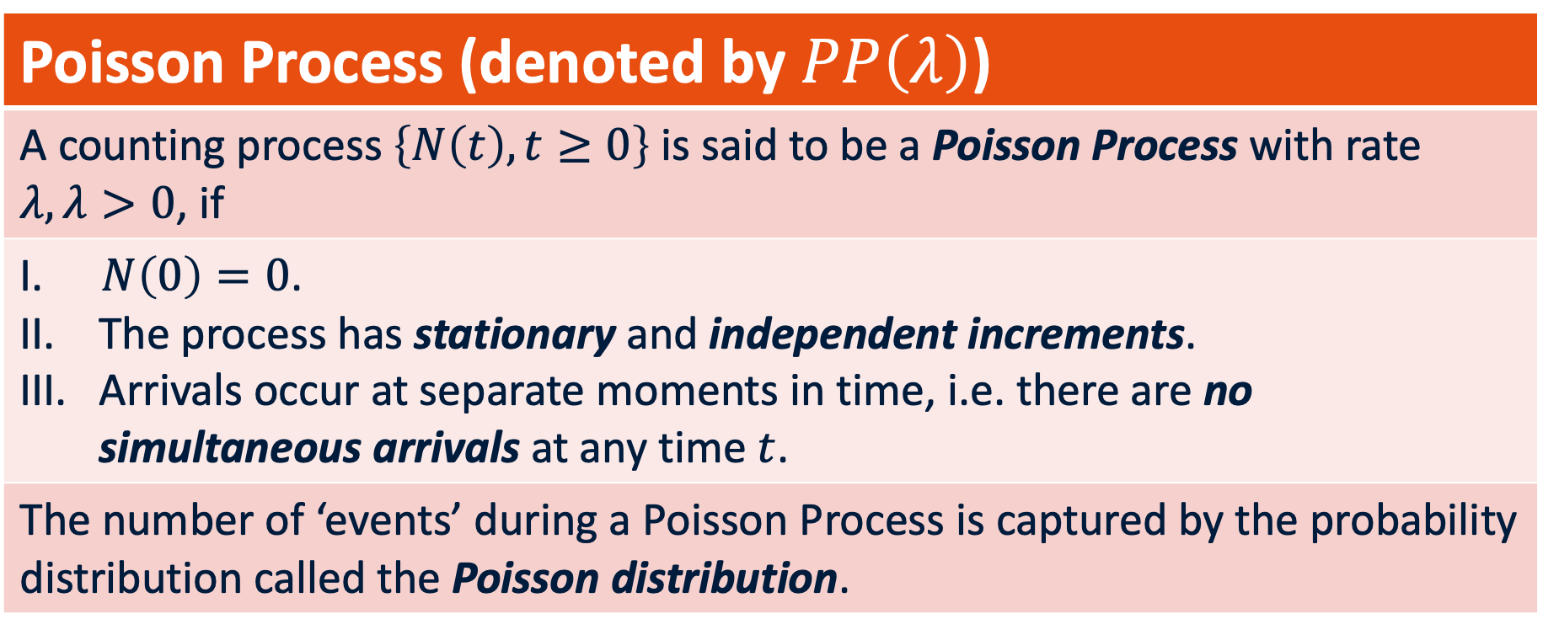
Poisson Process & Distribution
Poisson Process (denoted by $PP\left(λ\right)$)
A counting process $\left\{N\left(t\right), t≥0\right\}$ is said to be a Poisson Process with rate $λ,λ>0$, if
$N\left(0\right)=0$. The process has stationary and independent increments. Arrivals occur at separate moments in time, i.e. there are no simultaneous arrivals at any time $t$.
The number of ‘events’ during a Poisson Process is captured by the probability distribution called the Poisson distribution.

Slide 12
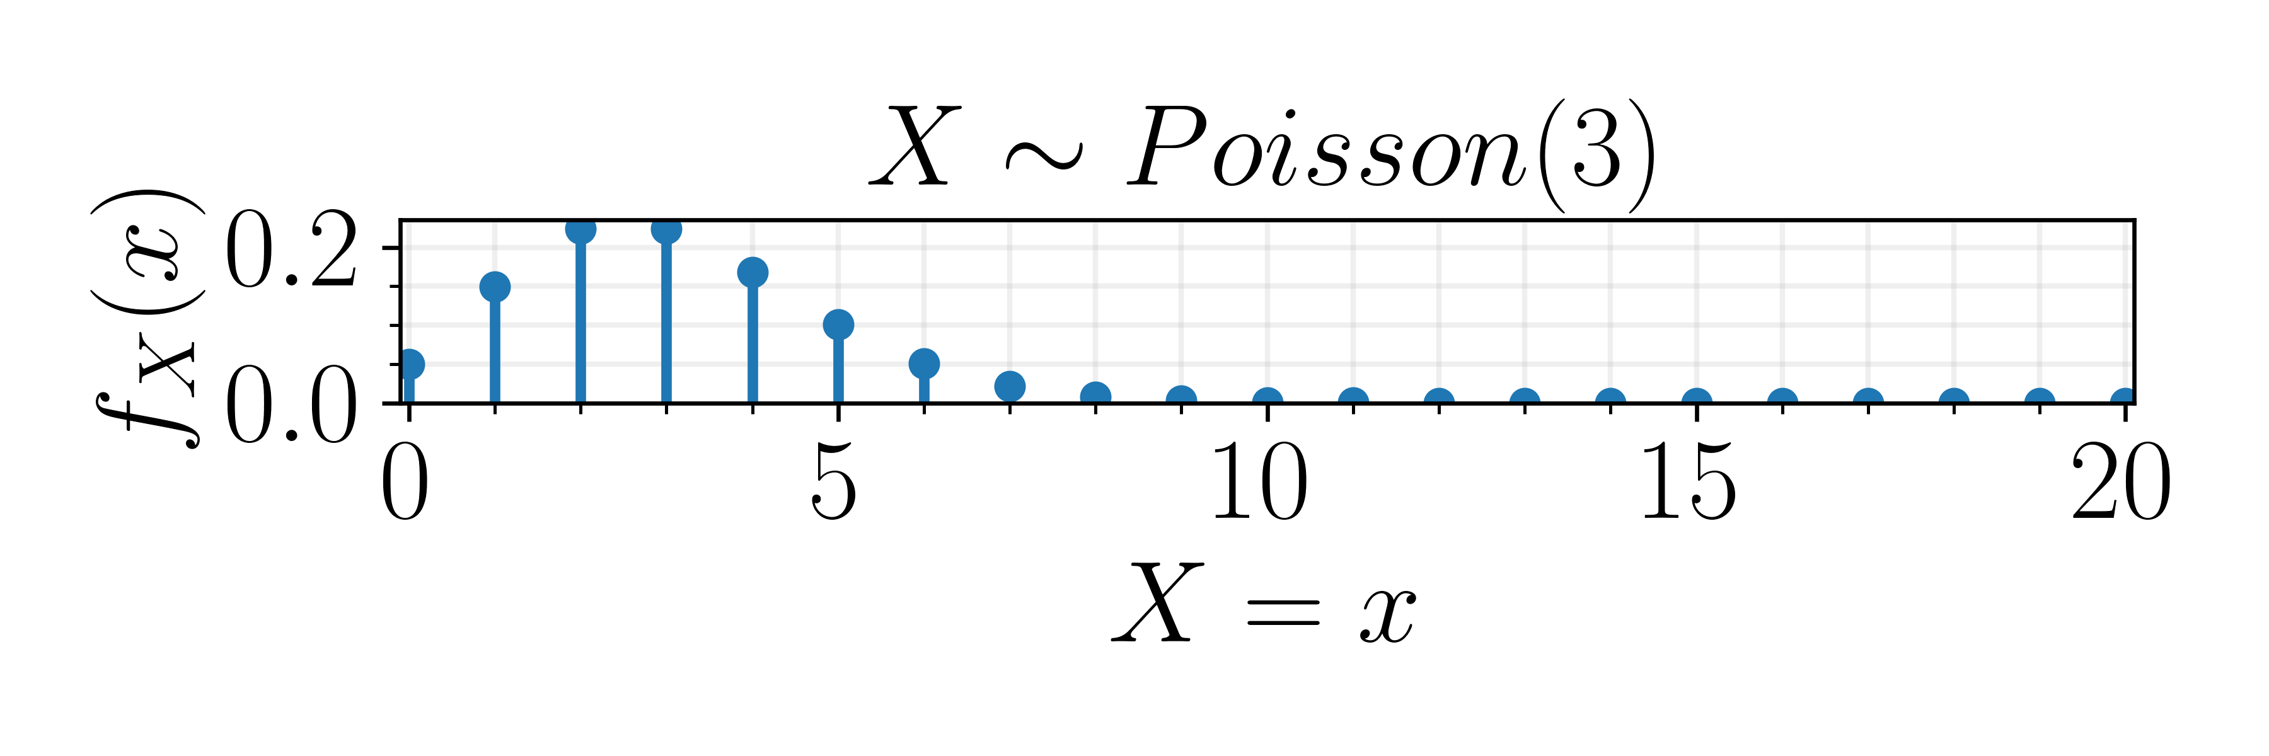
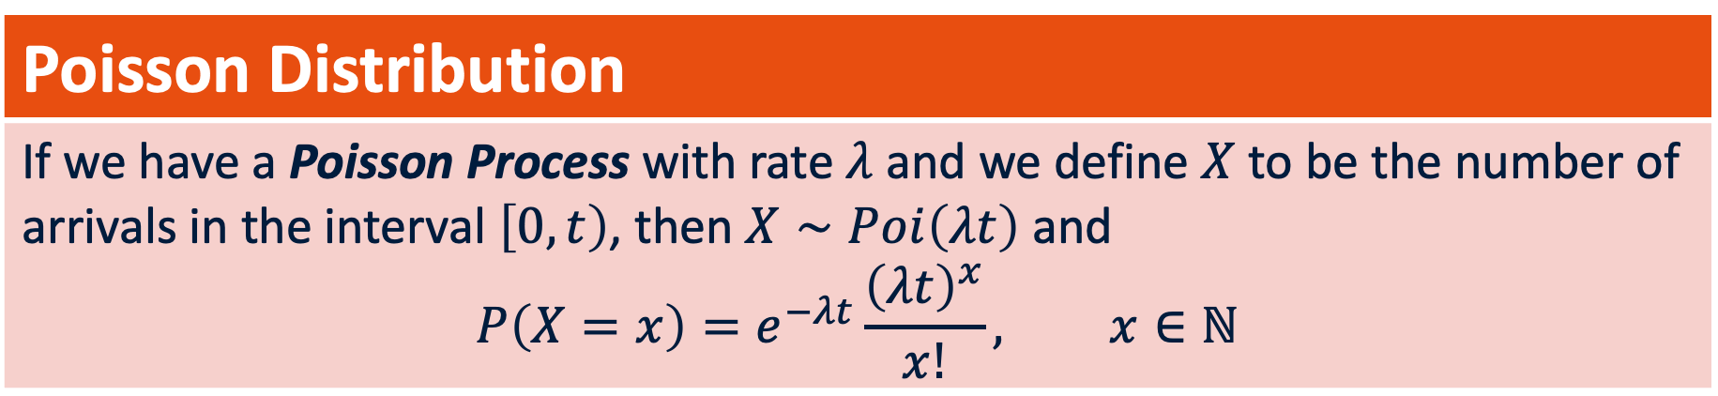

Poisson Process & Distribution
Poisson Distribution
If we have a Poisson Process with rate $λ$ and we define $X$ to be the number of arrivals in the interval $\left[0,t\right)$, then $X∼Poi\left(λt\right)$ and $$P\left(X=x\right)=e^{−λt}\frac{{\left(λt\right)}^{x}}{x!}, x∈ℕ$$
Descriptive statistics: $X∼Poi\left(λt\right)$
$$E\left[X\right]=λt, Var\left(X\right)=λt$$

Slide 13
Discrete Random Variables
This Poisson distribution comes from the assumption that the mean is 1.41 events/day.
We can then calculate a probability distribution which we multiply by the total count to get the histogram in black.
In grey is the observation.

Slide 14
Discrete Random Variables
Based on this, the P(5 homicides) = P(X = 5) = 0.011134.
Over 1095 days that is an expected frequency of 12 days.
The actual number of days was 13 so a very good match.
You will learn to test whether a distribution fits the data well in a future class.

Slide 15
Why do we want a distribution?
We could have used the natural frequencies directly right?
There is a branch of statistics that tries to do this: non-parametric statistics.
But. Having the distribution enables more complicated modeling, and comparisons across countries, for example.
Notes:
Having a distribution helps with creating a cost function.

Slide 16
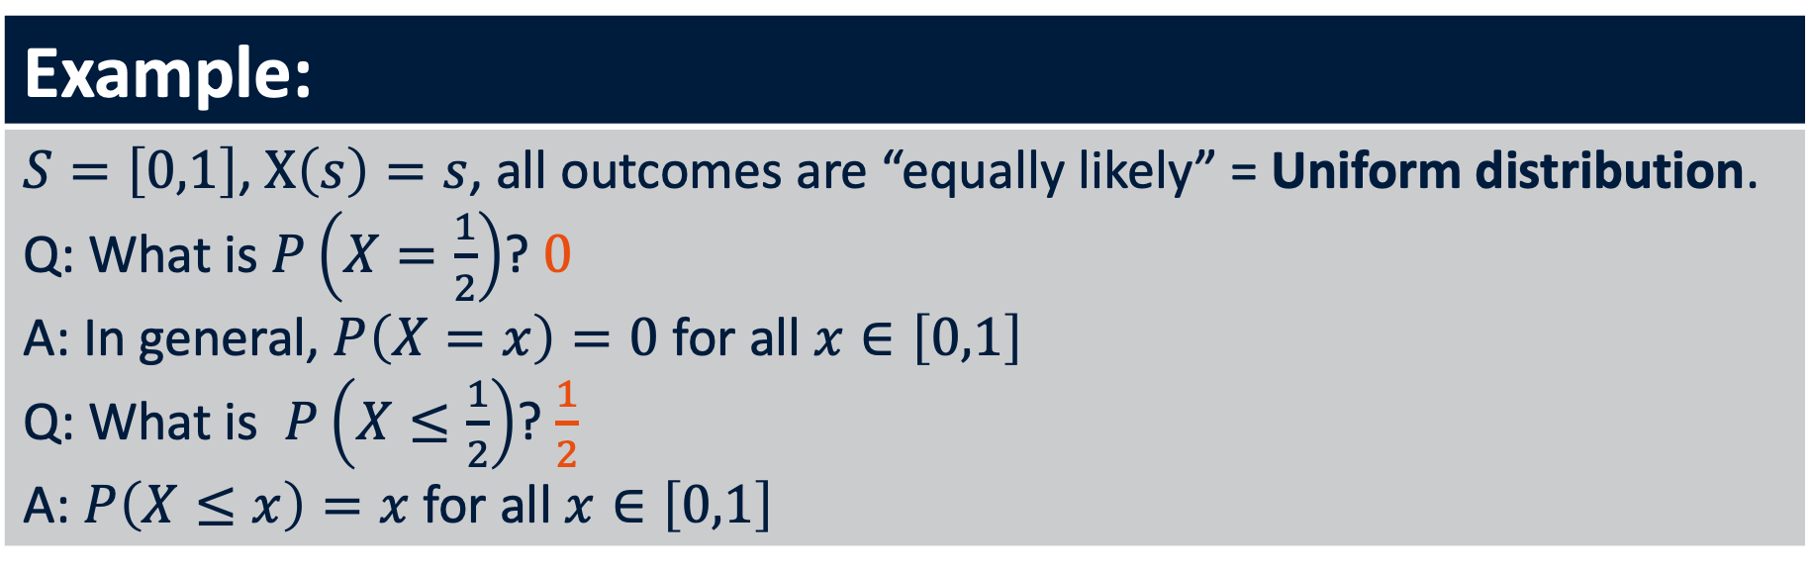

Continuous Random Variables
Example:
$S=\left[0,1\right]$, $X\left(s\right)=s$, all outcomes are “equally likely” = Uniform distribution. Q: What is $P\left(X=\frac{1}{2}\right)$? $0$ A: In general, $P\left(X=x\right)=0$for all $x∈\left[0,1\right]$ Q: What is $P\left(X≤\frac{1}{2}\right)$? $\frac{1}{2}$ A: $P\left(X≤x\right)=x$for all $x∈\left[0,1\right]$
Cumulative distribution (denoted by $F(x)$)
$F\left(x\right)=P(X≤x)$ (is well defined this way)
Notes:
Show calculation on paper.

Slide 17

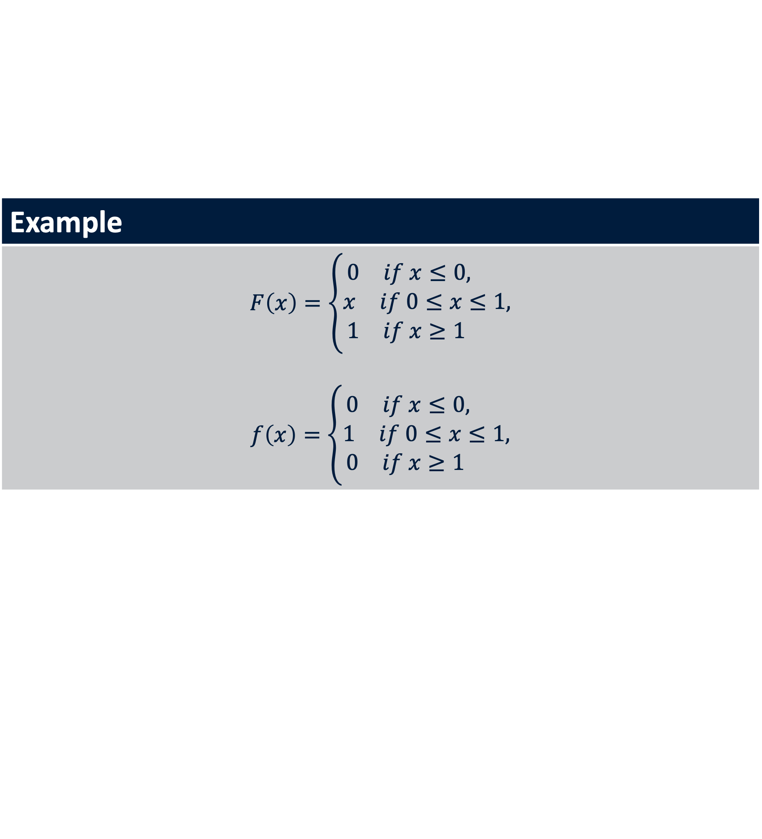
Continuous Random Variables
Probability density function (denoted by $f(x)$)
$$f\left(x\right)=F′(x)$$
Example
$$F\left(x\right)=\left\{\begin{aligned}\begin{matrix}0 & if x≤0, \end{matrix} \\ \begin{matrix}x & if 0≤x≤1,\end{matrix} \\ \begin{matrix}1 & if x≥1 \end{matrix}\end{aligned}\right.$$ $$f\left(x\right)=\left\{\begin{aligned}\begin{matrix}0 & if x≤0, \end{matrix} \\ \begin{matrix}1 & if 0≤x≤1,\end{matrix} \\ \begin{matrix}0 & if x≥1 \end{matrix}\end{aligned}\right.$$

Slide 18
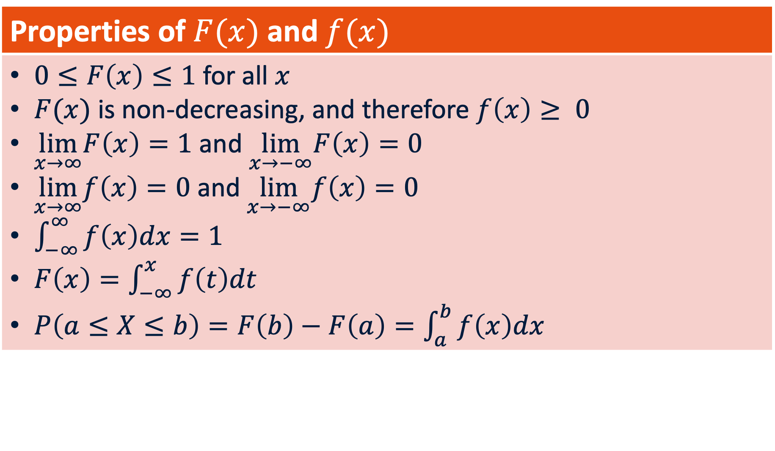
Continuous Random Variables
Properties of $F(x)$ and $f(x)$
$0≤F\left(x\right)≤1$ for all $x$ $F(x)$ is non-decreasing, and therefore $f\left(x\right)≥ 0$ $\lim_{x→∞}F\left(x\right)=1$ and $\lim_{x→−∞}F\left(x\right)=0$ $\lim_{x→∞}f\left(x\right)=0$ and $\lim_{x→−∞}f\left(x\right)=0$ $\int_{−∞}^{∞}{f\left(x\right)dx=1}$ $F\left(x\right)=\int_{−∞}^{x}{f\left(t\right)dt}$ $P\left(a≤X≤b\right)=F\left(b\right)−F\left(a\right)=\int_{a}^{b}{f\left(x\right)dx}$

Slide 19
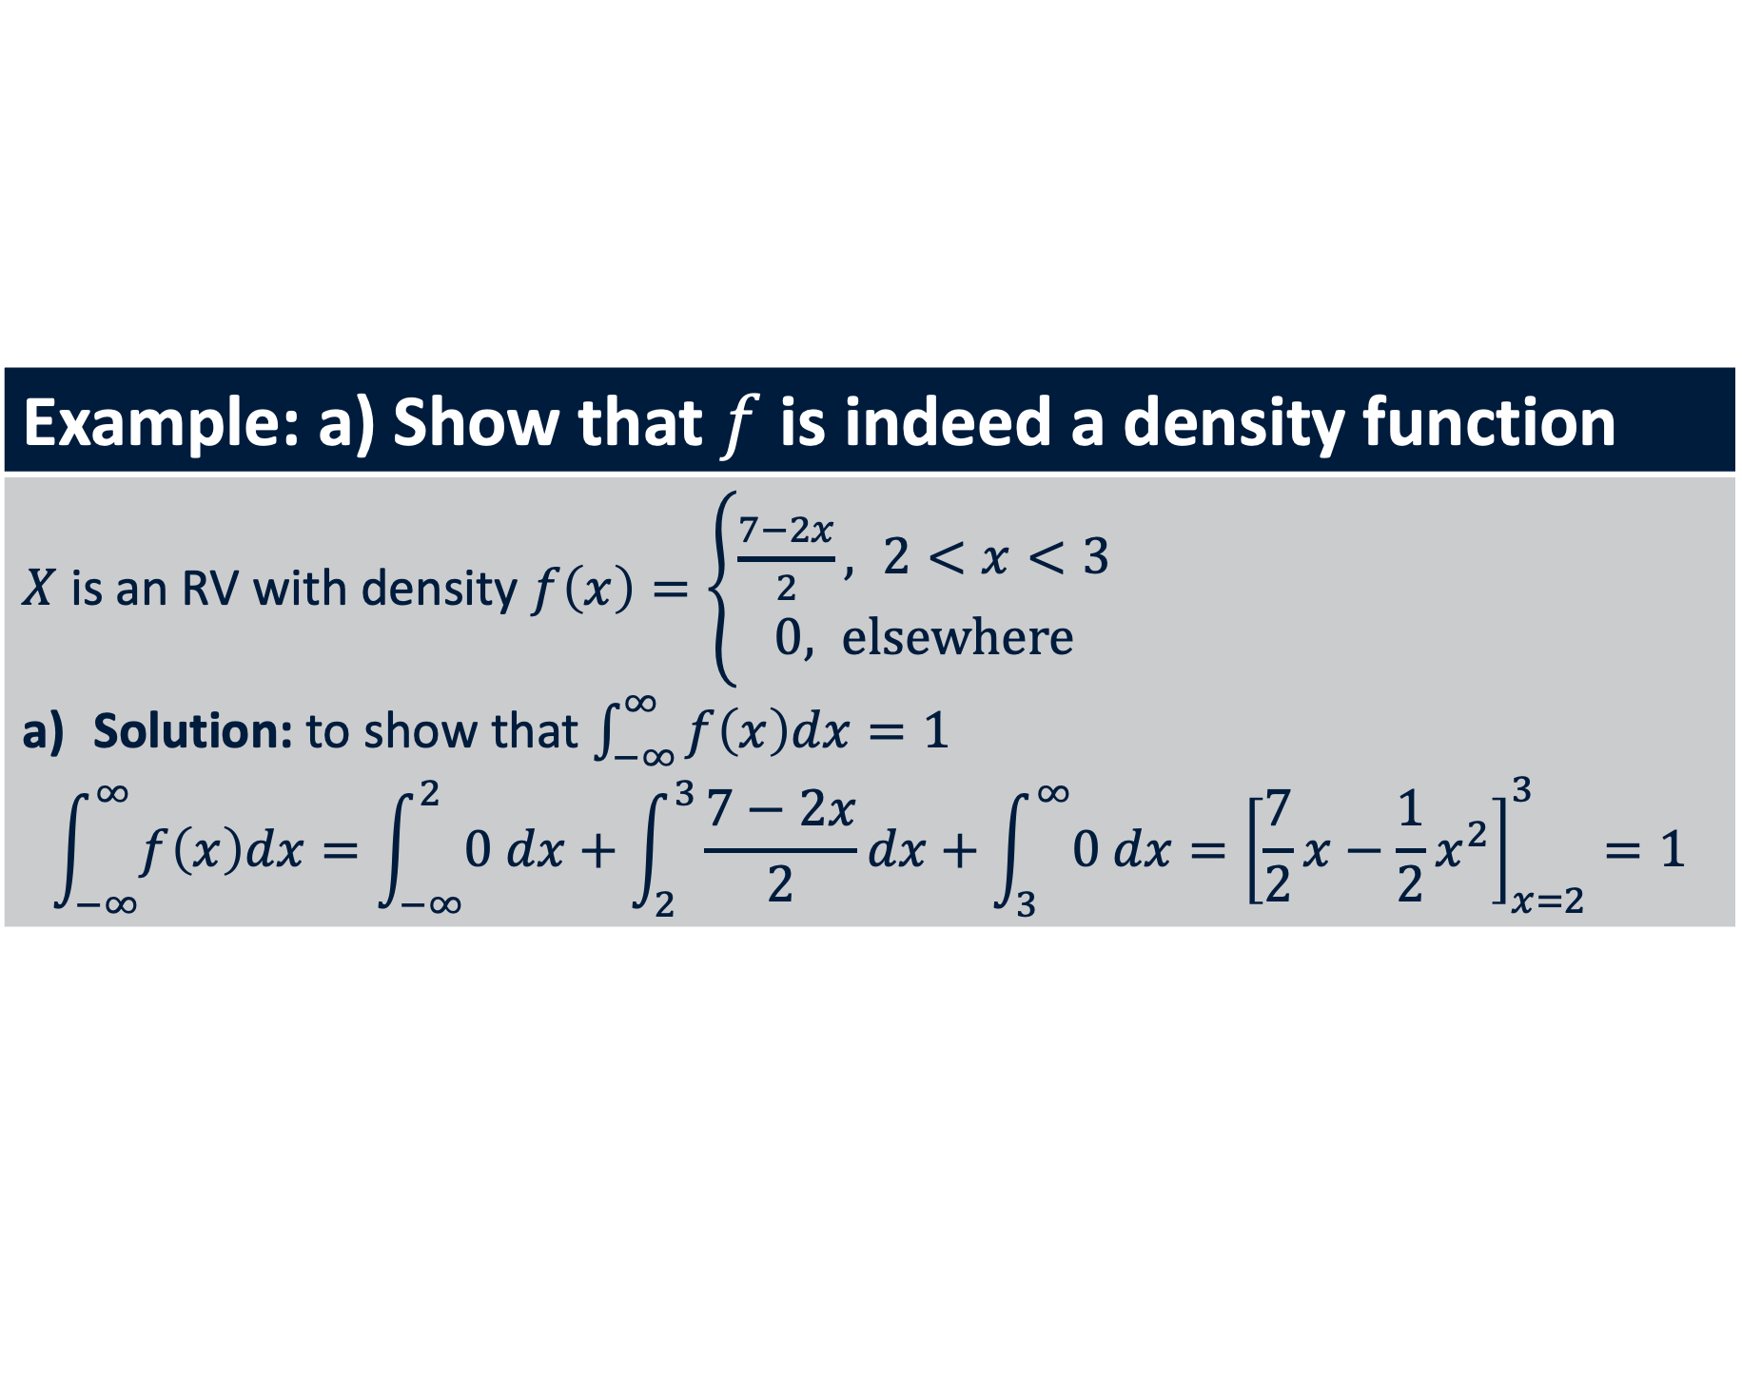
Continuous Random Variables
Example: a) Show that $f$ is indeed a density function
$X$ is an RV with density $f\left(x\right)=\left\{\begin{aligned}\frac{7−2x}{2}, 2<x<3 \\ &0, elsewhere\end{aligned}\right.$ Solution: to show that $\int_{−∞}^{∞}{f\left(x\right)dx=1}$ $$\int_{−∞}^{∞}{f\left(x\right)dx}=\int_{−∞}^{2}{0 dx}+\int_{2}^{3}{\frac{7−2x}{2}dx}+\int_{3}^{∞}{0 dx}={\left[\frac{7}{2}x−\frac{1}{2}x^{2}\right]}_{x=2}^{3}=1$$

Slide 20
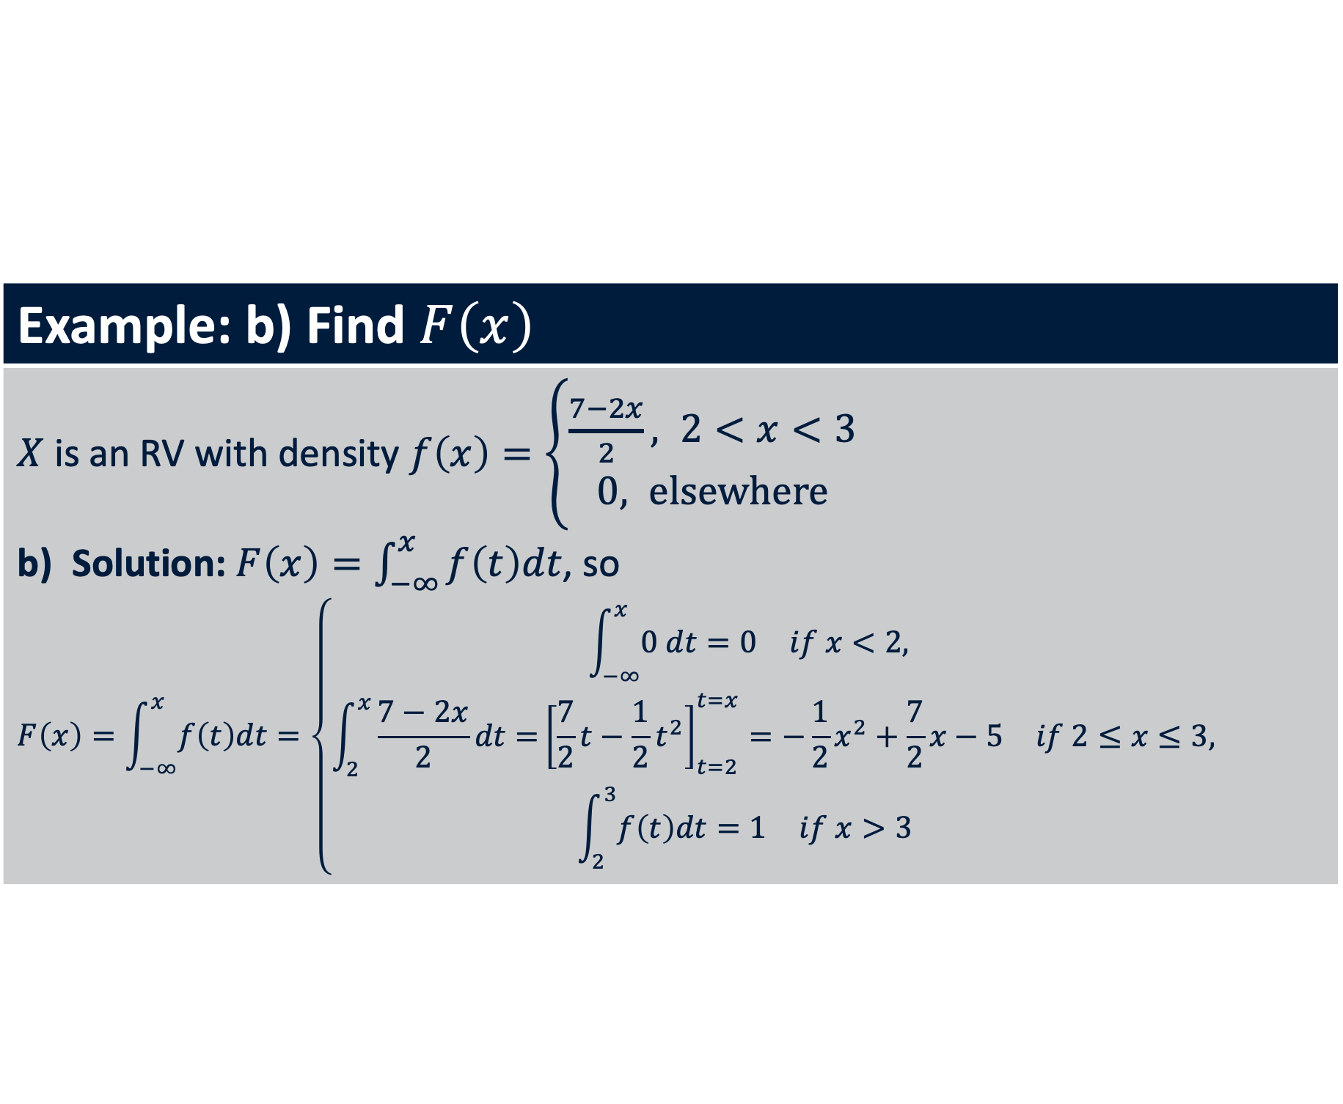
Continuous Random Variables
Example: b) Find $F\left(x\right)$
$X$ is an RV with density $f\left(x\right)=\left\{\begin{aligned}\frac{7−2x}{2}, 2<x<3 \\ &0, elsewhere\end{aligned}\right.$ Solution: $F\left(x\right)=\int_{−∞}^{x}{f\left(t\right)dt}$, so $$F\left(x\right)=\int_{−∞}^{x}{f\left(t\right)dt}=\left\{\begin{aligned}\begin{matrix}\int_{−∞}^{x}{0 dt}=0 & if x<2, \end{matrix} \\ \begin{matrix}\int_{2}^{x}{\frac{7−2x}{2}dt=}{\left[\frac{7}{2}t−\frac{1}{2}t^{2}\right]}_{t=2}^{t=x}=−\frac{1}{2}x^{2}+\frac{7}{2}x−5 & if 2≤x≤3,\end{matrix} \\ \begin{matrix}\int_{2}^{3}{f\left(t\right)dt}=1 & if x>3 \end{matrix}\end{aligned}\right.$$

Slide 21
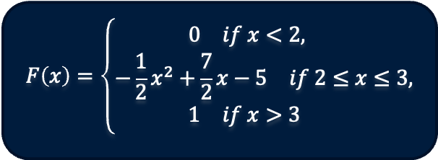
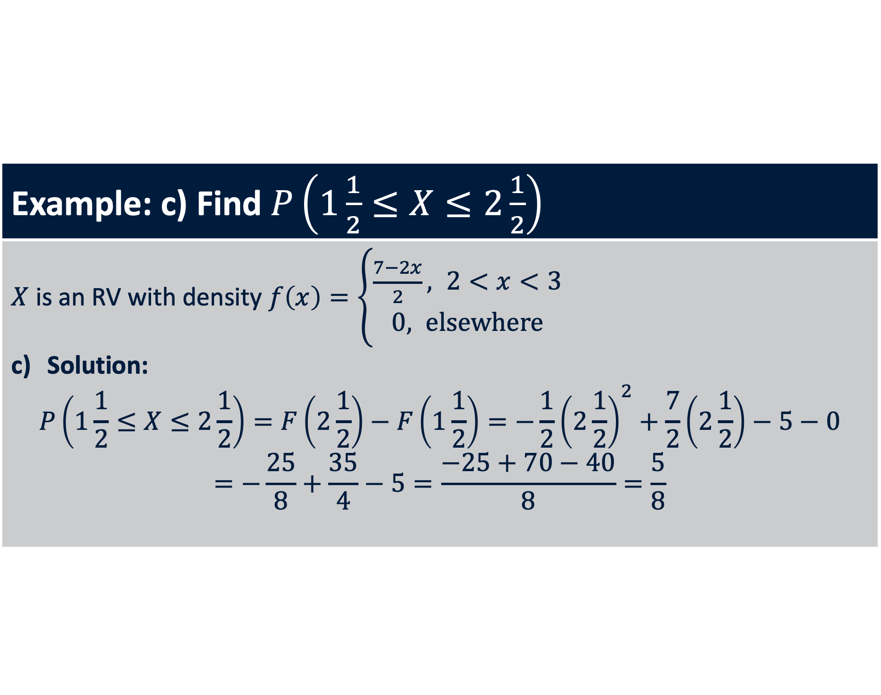
Continuous Random Variables
Example: c) Find $P\left(1\frac{1}{2}≤X≤2\frac{1}{2}\right)$
$X$ is an RV with density $f\left(x\right)=\left\{\begin{aligned}\frac{7−2x}{2}, 2<x<3 \\ &0, elsewhere\end{aligned}\right.$ Solution: $$P\left(1\frac{1}{2}≤X≤2\frac{1}{2}\right)=F\left(2\frac{1}{2}\right)−F\left(1\frac{1}{2}\right)=−\frac{1}{2}{\left(2\frac{1}{2}\right)}^{2}+\frac{7}{2}\left(2\frac{1}{2}\right)−5−0=−\frac{25}{8}+\frac{35}{4}−5=\frac{−25+70−40}{8}=\frac{5}{8}$$
$$F\left(x\right)=\left\{\begin{aligned}\begin{matrix}0 & if x<2, \end{matrix} \\ \begin{matrix}−\frac{1}{2}x^{2}+\frac{7}{2}x−5 & if 2≤x≤3,\end{matrix} \\ \begin{matrix}1 & if x>3 \end{matrix}\end{aligned}\right.$$

Slide 22
Summaries of Random Variables
When we take the mean of homicide events, then we are averaging over all the outcomes from random variables for each day.
We can also calculate other statistics here: median, standard deviation and so on.
And these statistics are in fact also random variables coming from their own probability distributions (a.k.a the “sampling distribution”).

Slide 23
The mean
Mean is also called the expectation – though the ‘expectation’ has a clearer mathematical definition in probability.
Why is it called expectation? It is the most expected amount for a random variable, at least for symmetric random variables.
How is the mean distributed for the proportion of left handed individuals in the world?

Slide 24
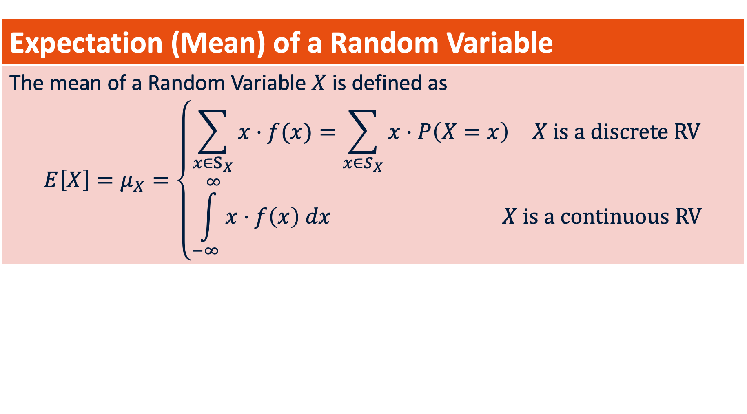
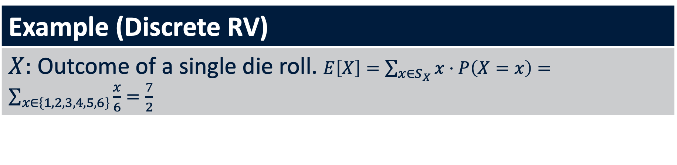
Mathematical Expectation
Expectation (Mean) of a Random Variable
The mean of a Random Variable $X$ is defined as $$E\left[X\right]=μ_{X}=\left\{\begin{aligned}\begin{matrix}\sum_{x∈S_{X}}{x⋅f(x)}=\sum_{x∈S_{X}}{x⋅P\left(X=x\right)} & X is a discrete RV\end{matrix} \\ \begin{matrix}\int_{−∞}^{∞}{x⋅f\left(x\right) dx} & X is a continuous RV\end{matrix}\end{aligned}\right.$$
Example (Discrete RV)
$X:$ Outcome of a single die roll. $E\left[X\right]=\sum_{x∈S_{X}}{x⋅P\left(X=x\right)}=\sum_{x∈\left\{1,2,3,4,5,6\right\}}{\frac{x}{6}=\frac{7}{2}}$
Notes:
Note how this looks exactly like a simple mean. But now generalized.

Slide 25
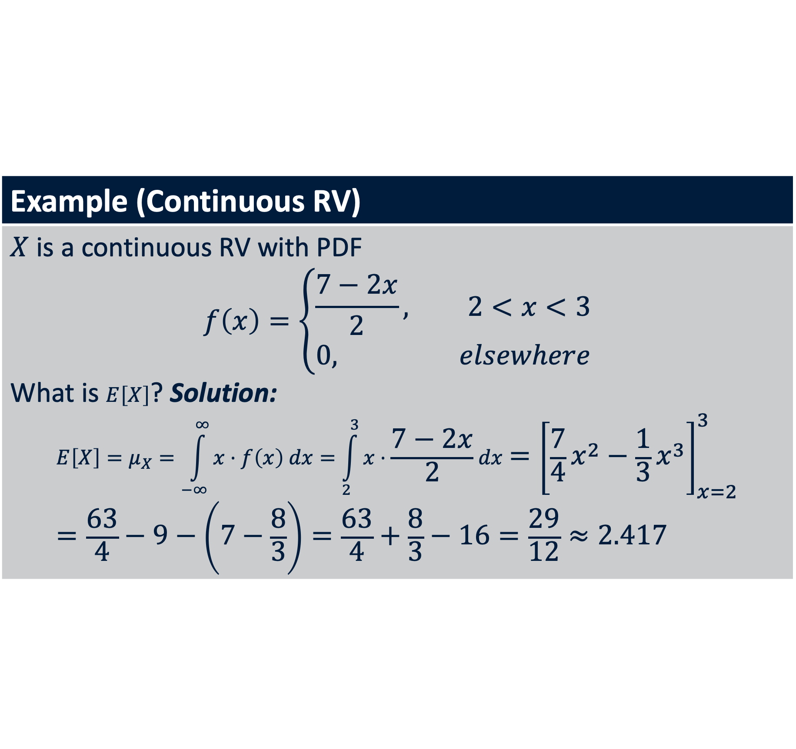
Mathematical Expectation
Example (Continuous RV)
$X$ is a continuous RV with PDF $$f\left(x\right)=\left\{\begin{aligned}\frac{7−2x}{2}, 2<x<3 \\ &0, elsewhere\end{aligned}\right.$$ What is $E\left[X\right]$? Solution: $$E\left[X\right]=μ_{X}=\int_{−∞}^{∞}{x⋅f\left(x\right) dx}=\int_{2}^{3}{x⋅\frac{7−2x}{2}dx}={\left[\frac{7}{4}x^{2}−\frac{1}{3}x^{3}\right]}_{x=2}^{3}=\frac{63}{4}−9−\left(7−\frac{8}{3}\right)=\frac{63}{4}+\frac{8}{3}−16=\frac{29}{12}≈2.417$$

Slide 26
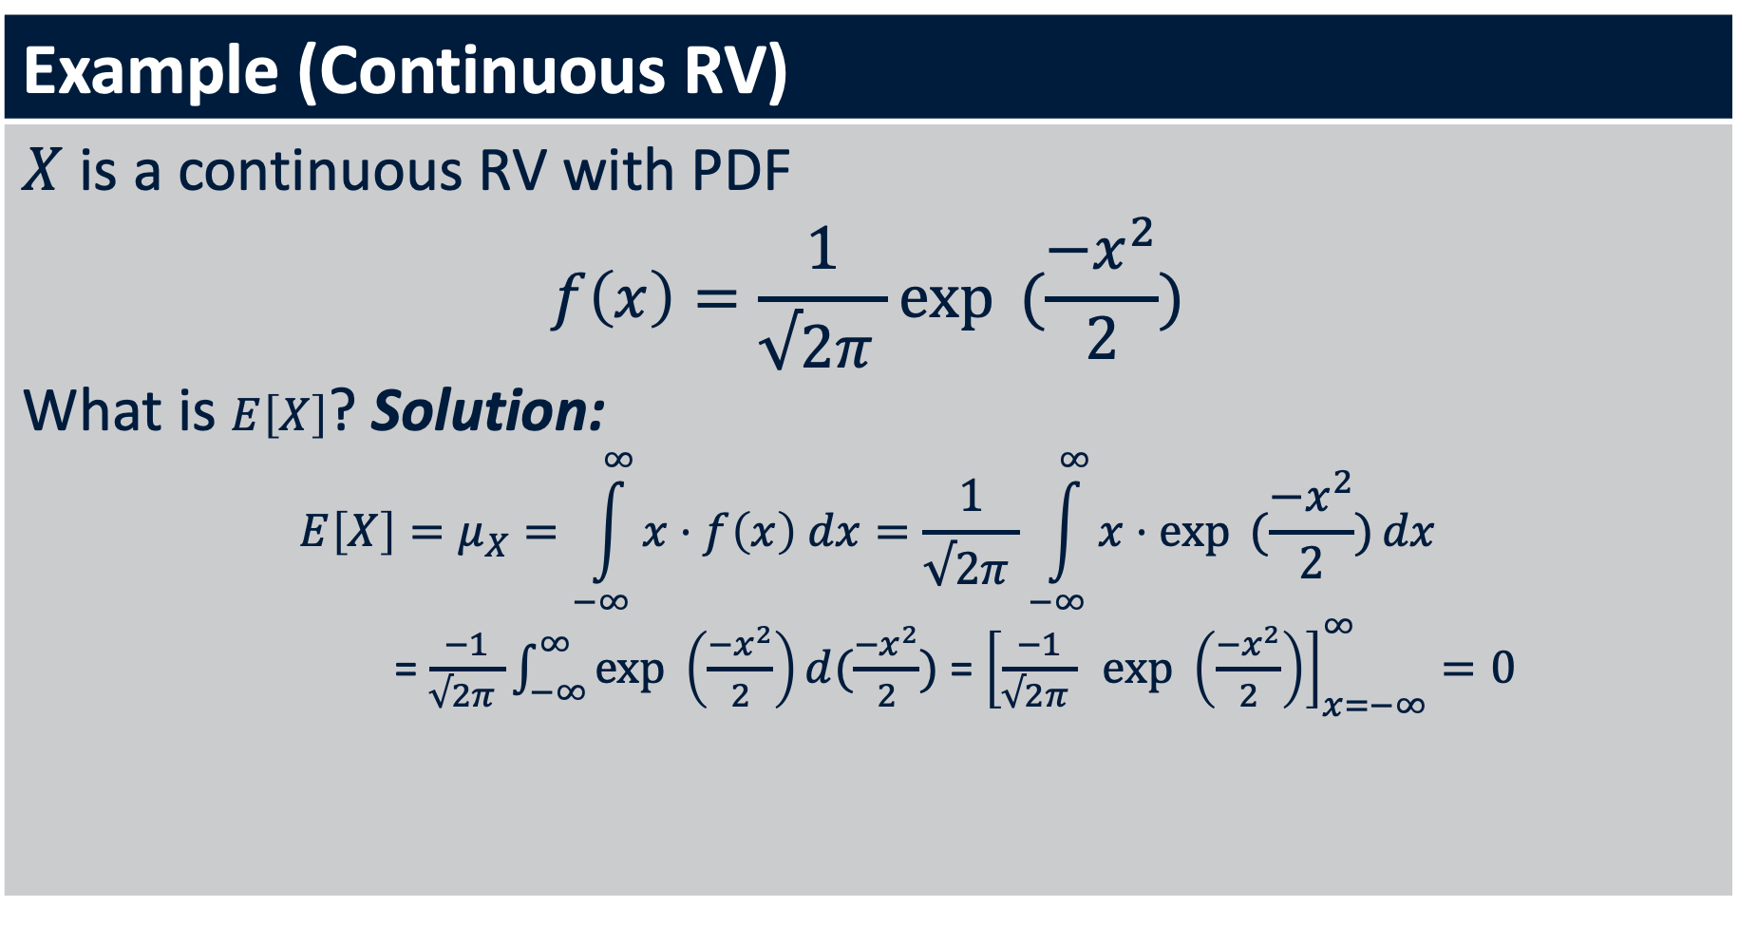
Mathematical Expectation
Example (Continuous RV)
$X$ is a continuous RV with PDF $$f\left(x\right)=\frac{1}{√2π }\exp{ (\frac{{−x}^{2}}{2})}$$ What is $E\left[X\right]$? Solution: $$E\left[X\right]=μ_{X}=\int_{−∞}^{∞}{x⋅f\left(x\right) dx}=\frac{1}{√2π }\int_{−∞}^{∞}{x⋅\exp{ (\frac{{−x}^{2}}{2})}dx}$$ = $\frac{−1}{√2π }\int_{−∞}^{∞}{\exp{ \left(\frac{{−x}^{2}}{2}\right)}d(\frac{{−x}^{2}}{2})}$ = ${\left[\frac{−1}{√2π } \exp{ \left(\frac{{−x}^{2}}{2}\right)}\right]}_{x=−∞}^{∞}=0$

Slide 27
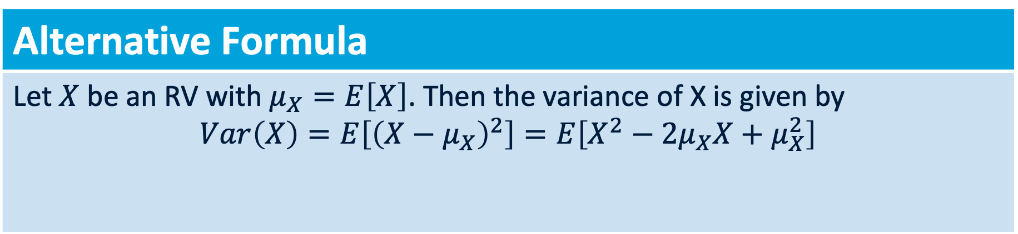
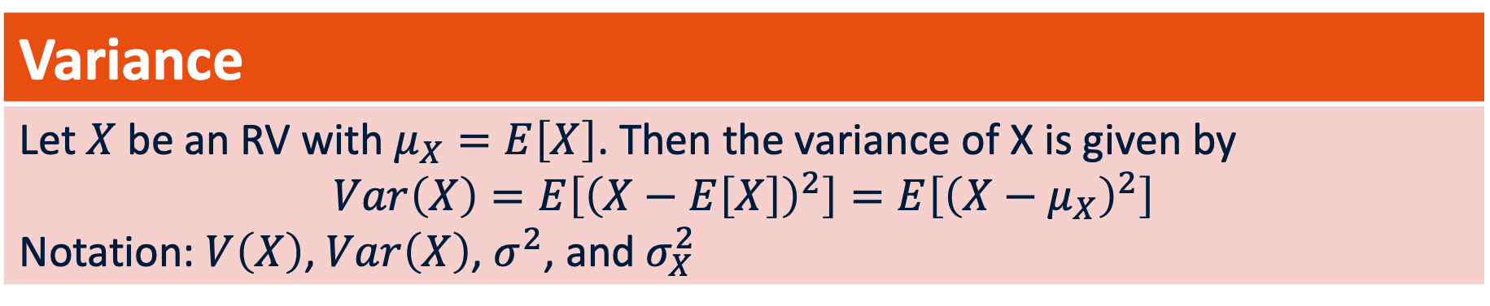
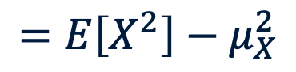
Variance of a Random Variable
Variance
Let $X$ be an RV with $μ_{X}=E\left[X\right]$. Then the variance of X is given by $$Var\left(X\right)=E\left[{\left(X−E\left[X\right]\right)}^{2}\right]=E\left[{\left(X−μ_{X}\right)}^{2}\right]$$ Notation: $V\left(X\right)$, $Var\left(X\right)$, $σ^{2}$, and $σ_{X}^{2}$
Alternative Formula
Let $X$ be an RV with $μ_{X}=E\left[X\right]$. Then the variance of X is given by $$Var\left(X\right)=E\left[{\left(X−μ_{X}\right)}^{2}\right]=E\left[X^{2}−2μ_{X}X+μ_{X}^{2}\right]$$
$$=E\left[X^{2}\right]−2μ_{X}E\left[X\right]+μ_{X}^{2}=E\left[X^{2}\right]−2μ_{X}^{2}+μ_{X}^{2}$$
$$=E\left[X^{2}\right]−μ_{X}^{2}$$
Observation: always non-negative

Slide 28
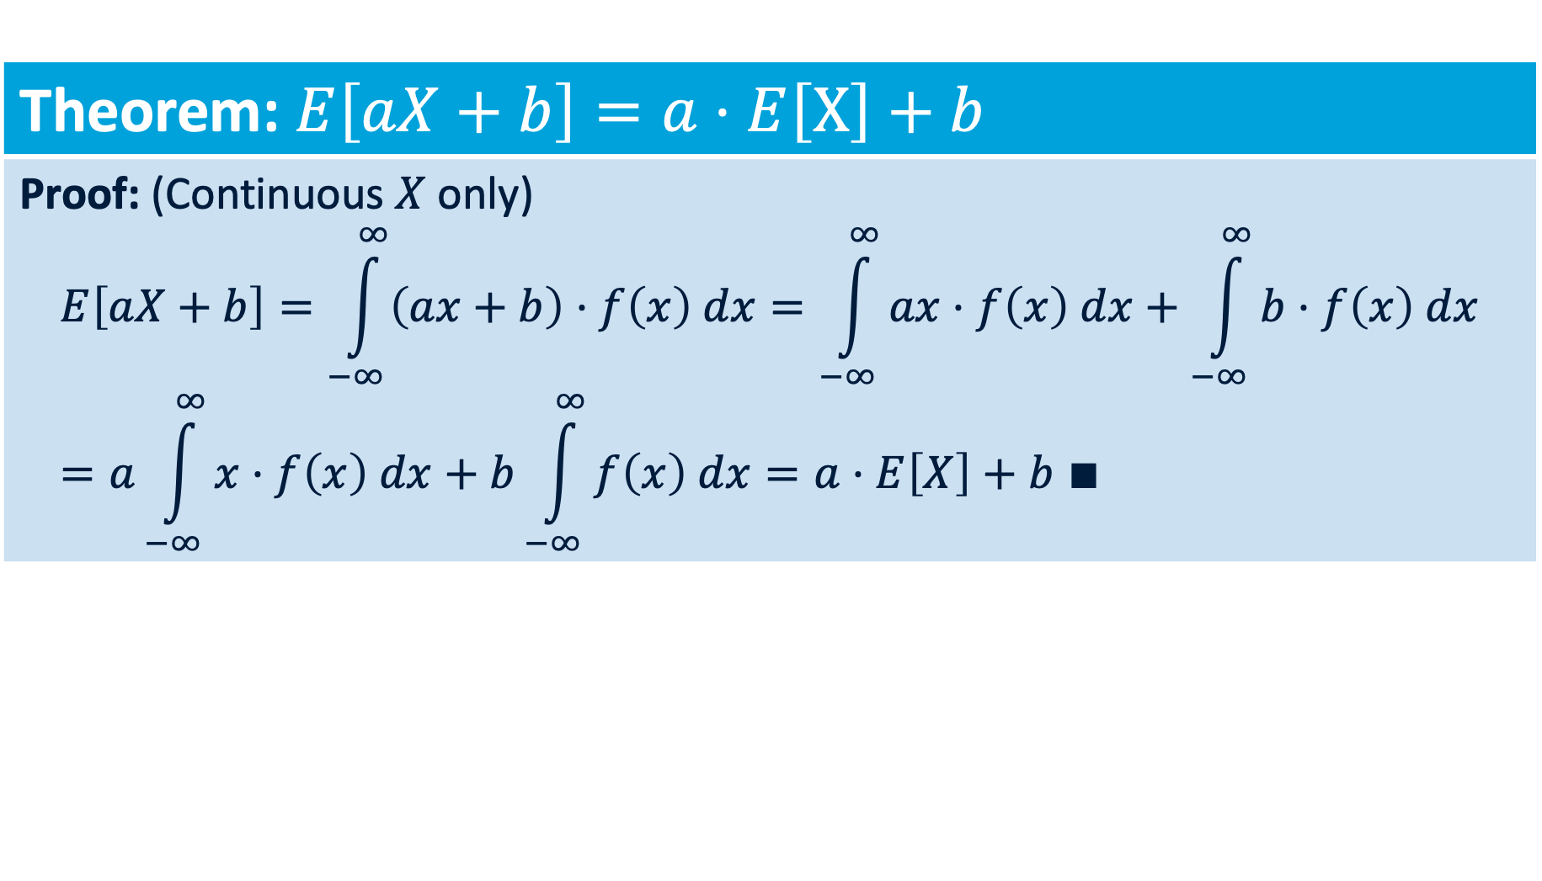
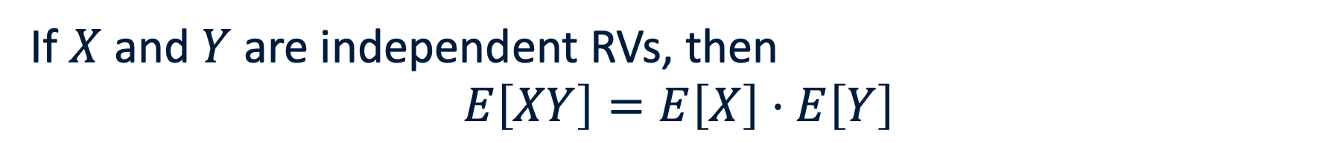
Mathematical Expectation
Theorem: $E\left[aX+b\right]=a⋅E\left[X\right]+b$
Proof: (Continuous $X$ only) $$E\left[aX+b\right]=\int_{−∞}^{∞}{\left(ax+b\right)⋅f\left(x\right) dx}=\int_{−∞}^{∞}{ax⋅f\left(x\right) dx}+\int_{−∞}^{∞}{b⋅f\left(x\right) dx}=a\int_{−∞}^{∞}{x⋅f\left(x\right) dx}+b\int_{−∞}^{∞}{f\left(x\right) dx}=a⋅E\left[X\right]+b ∎$$
If $X$ and $Y$ are independent RVs, then
$$E\left[XY\right]=E\left[X\right]⋅E\left[Y\right]$$
Notes:
How were we able to do the algebra of splitting the expectation. Well, because integration is linear!

Slide 29
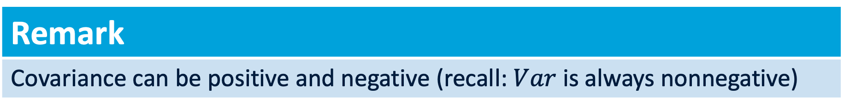
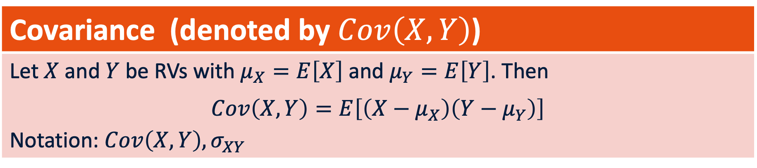
Covariance between Random Variables
Intuition
Dependence of realizations of random variables.
Covariance (denoted by $Cov\left(X,Y\right)$)
Let $X$ and $Y$ be RVs with $μ_{X}=E\left[X\right]$ and $μ_{Y}=E\left[Y\right]$. Then $$Cov\left(X,Y\right)=E\left[\left(X−μ_{X}\right)\left(Y−μ_{Y}\right)\right]$$ Notation: $Cov\left(X,Y\right), σ_{XY}$
Remark
Covariance can be positive and negative (recall: $Var$ is always nonnegative)

Slide 30
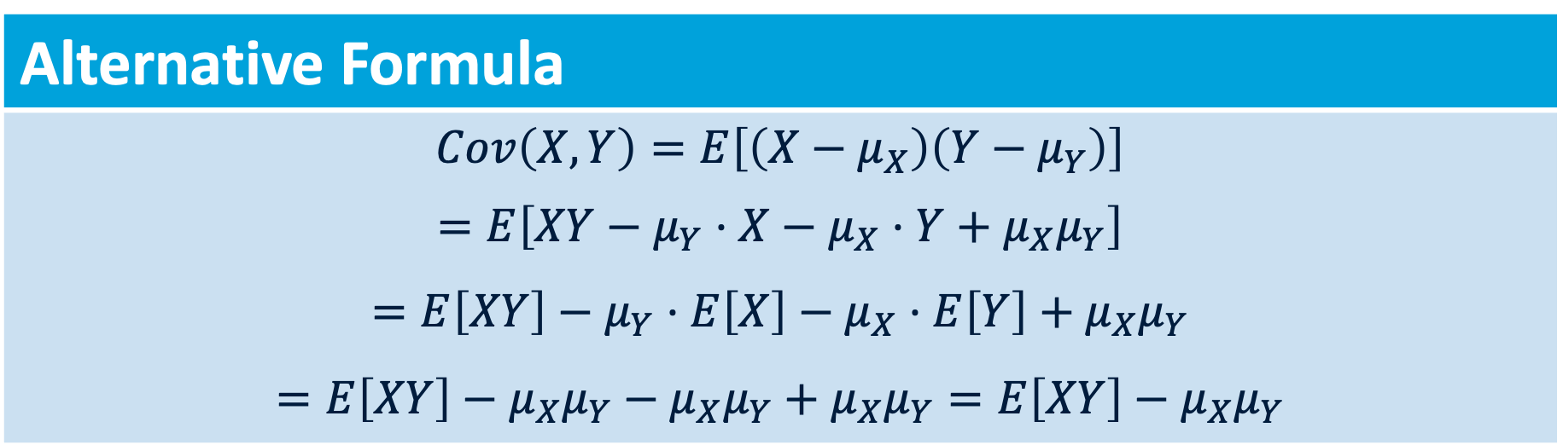
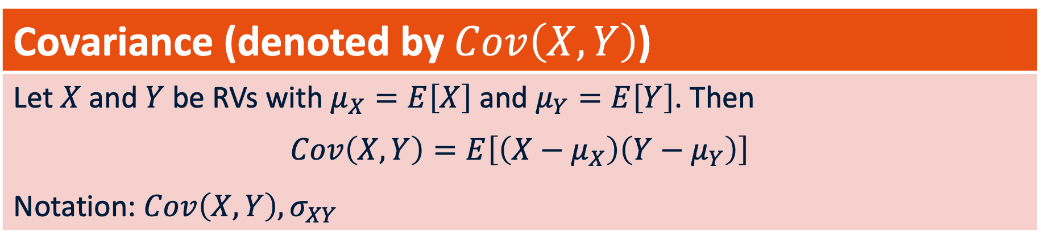
Covariance between Random Variables
Covariance (denoted by $Cov\left(X,Y\right)$)
Let $X$ and $Y$ be RVs with $μ_{X}=E\left[X\right]$ and $μ_{Y}=E\left[Y\right]$. Then $$Cov\left(X,Y\right)=E\left[\left(X−μ_{X}\right)\left(Y−μ_{Y}\right)\right]$$ Notation: $Cov\left(X,Y\right), σ_{XY}$
Alternative Formula
$$Cov\left(X,Y\right)=E\left[\left(X−μ_{X}\right)\left(Y−μ_{Y}\right)\right]$$ $$=E\left[XY−μ_{Y}⋅X−μ_{X}⋅Y+μ_{X}μ_{Y}\right]$$ $$=E\left[XY\right]−μ_{Y}⋅E\left[X\right]−μ_{X}⋅E\left[Y\right]+μ_{X}μ_{Y}$$ $$=E\left[XY\right]−{μ_{X}μ}_{Y}−μ_{X}μ_{Y}+μ_{X}μ_{Y}=E\left[XY\right]−μ_{X}μ_{Y}$$

Slide 31

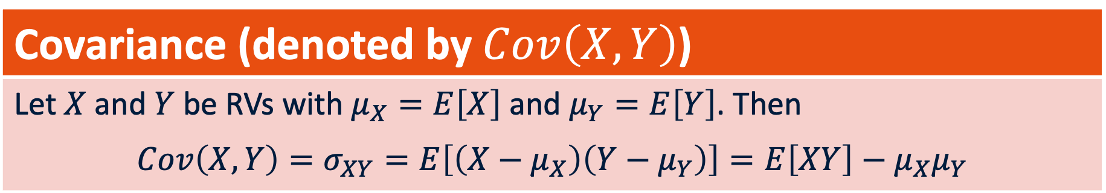
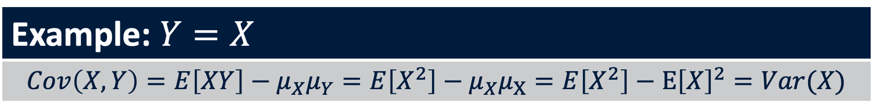
Covariance between Random Variables
Covariance (denoted by $Cov\left(X,Y\right)$)
Let $X$ and $Y$ be RVs with $μ_{X}=E\left[X\right]$ and $μ_{Y}=E\left[Y\right]$. Then $$Cov\left(X,Y\right)=σ_{XY}=E\left[\left(X−μ_{X}\right)\left(Y−μ_{Y}\right)\right]=E\left[XY\right]−μ_{X}μ_{Y}$$
Example: $X, Y$independent RVs
$$Cov\left(X,Y\right)=E\left[XY\right]−μ_{X}μ_{Y}=E\left[X\right]⋅E\left[Y\right]−E\left[X\right]⋅E\left[Y\right]=0$$
Example: $Y=X$
$$Cov\left(X,Y\right)=E\left[XY\right]−μ_{X}μ_{Y}=E\left[X^{2}\right]−μ_{X}μ_{X}=E\left[X^{2}\right]−E{\left[X\right]}^{2}=Var(X)$$

Slide 32
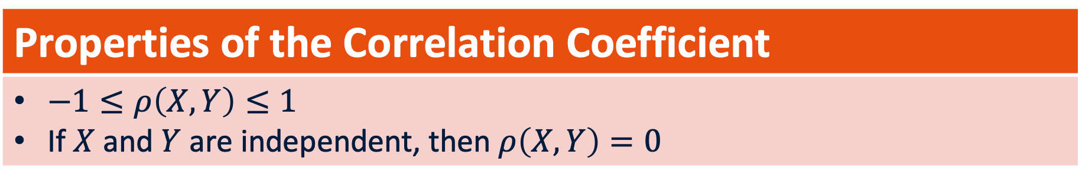
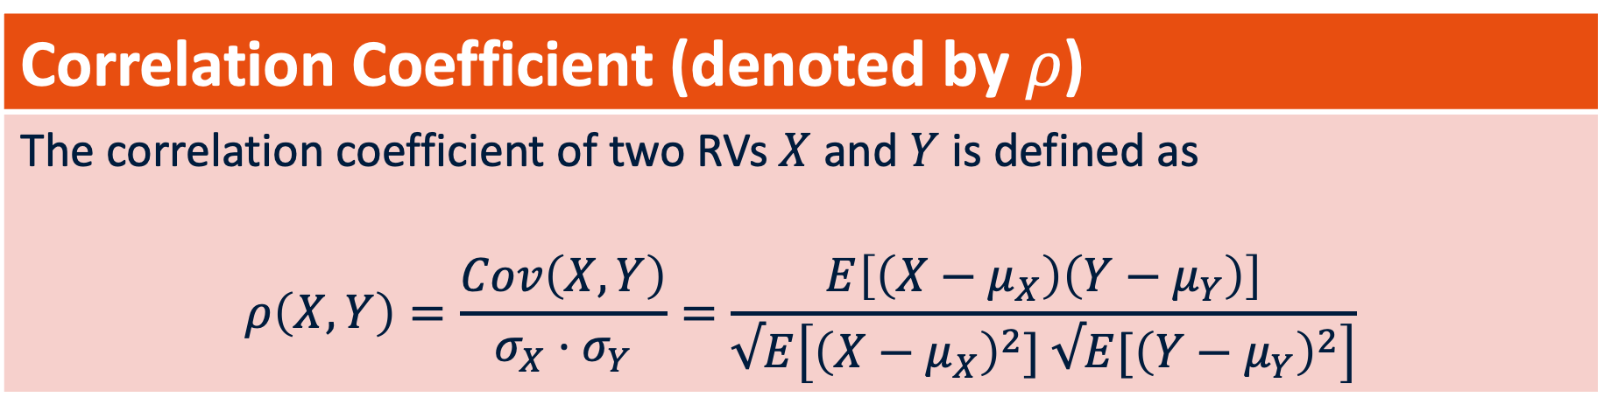
Correlation between Random Variables
Correlation Coefficient (denoted by $ρ$)
The correlation coefficient of two RVs $X$ and $Y$ is defined as $$ρ\left(X,Y\right)=\frac{Cov\left(X,Y\right)}{σ_{X}⋅σ_{Y}}=\frac{E\left[\left(X−μ_{X}\right)\left(Y−μ_{Y}\right)\right]}{√E\left[{\left(X−μ_{X}\right)}^{2}] √E[{\left(Y−μ_{Y}\right)}^{2}\right]}$$
Properties of the Correlation Coefficient
$−1≤ρ\left(X,Y\right)≤1$ If $X$ and $Y$ are independent, then $ρ\left(X,Y\right)=0$

Slide 33
Bernoulli Distribution
Any individual’s handedness comes from a discrete probability distribution with some probability for left-handedness and some probability for right-handedness.
What is the random variable?
This random variable comes from a Bernoulli distribution, which we have encountered before, for coin tosses. There is a probability p on right-handedness and 1-p on left handedness.

Slide 34
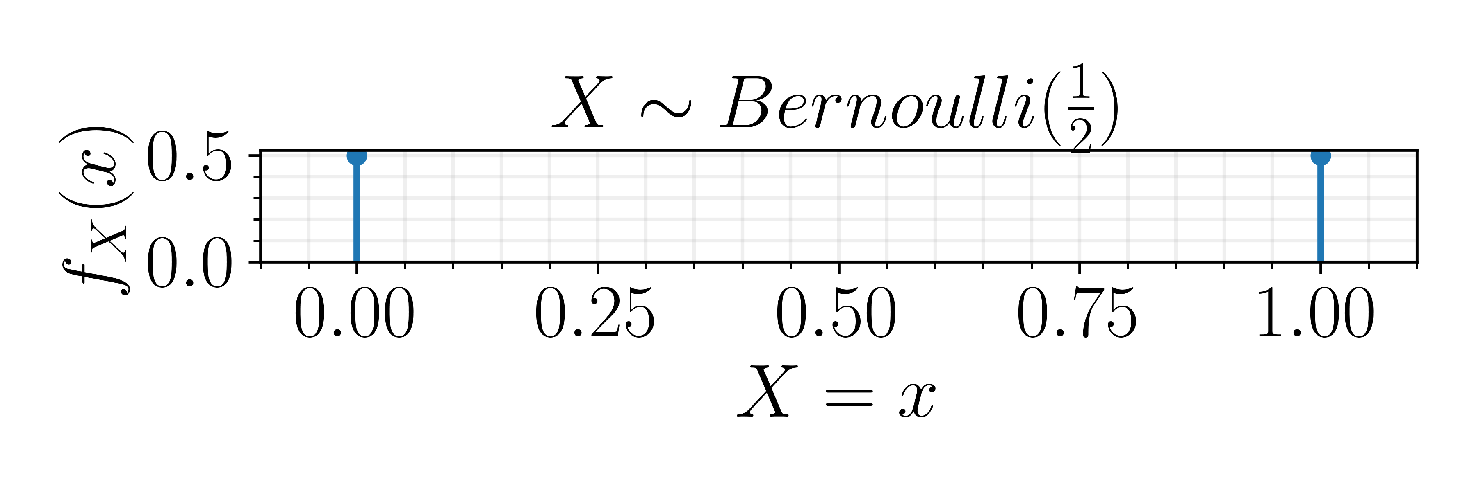
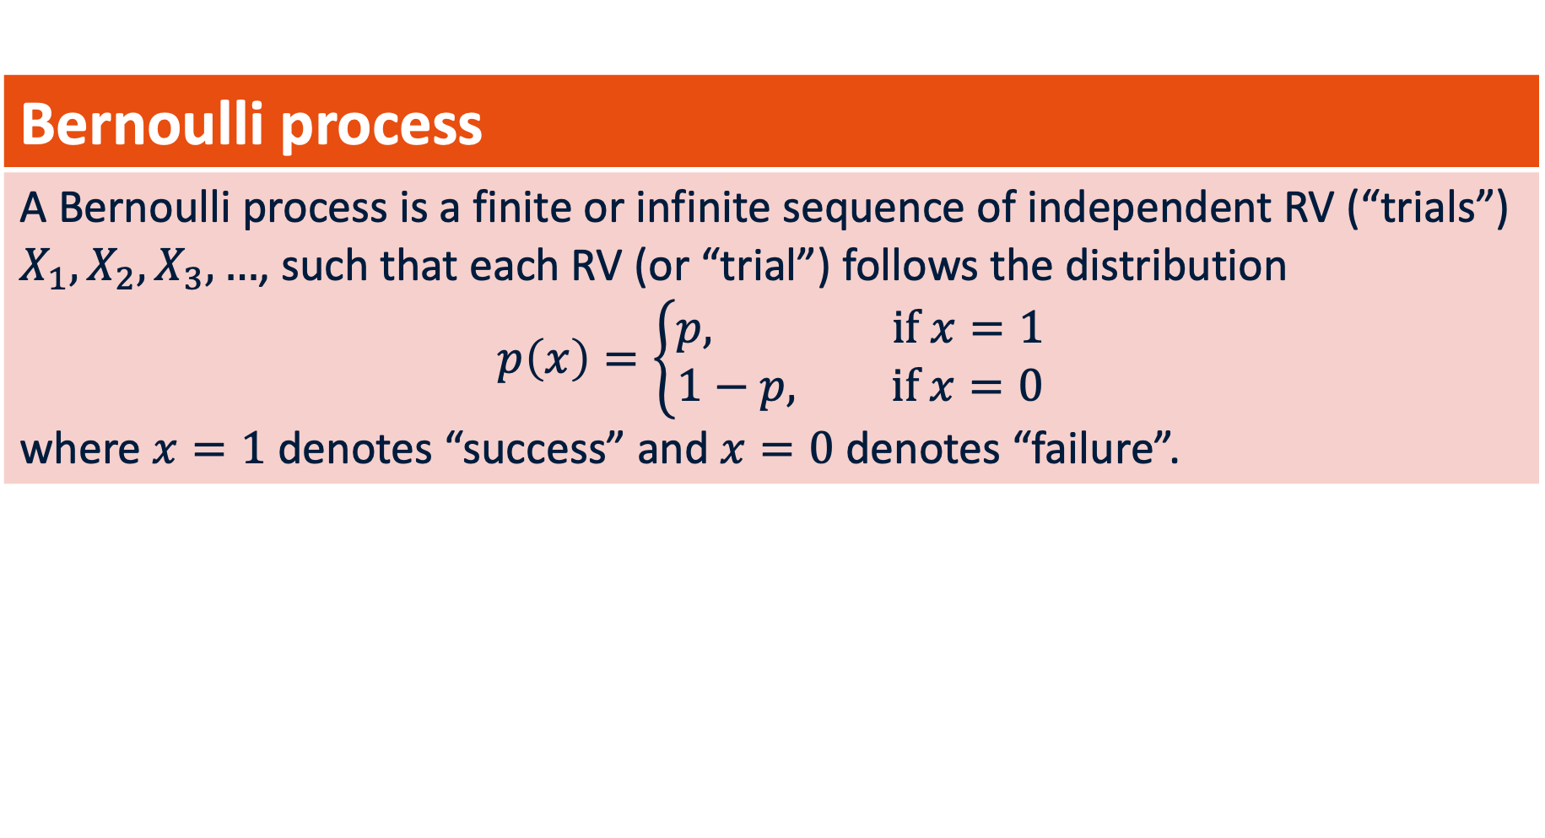
Bernoulli distribution
Bernoulli process
A Bernoulli process is a finite or infinite sequence of independent RV (“trials”) $X_{1}, X_{2}, X_{3}, …$, such that each RV (or “trial”) follows the distribution $$p\left(x\right)=\left\{\begin{aligned}p, if x=1 \\ &1−p, if x=0\end{aligned}\right.$$ where $x=1$ denotes “success” and $x=0$ denotes “failure”.
In a crowd, we expect that if we were shaking hands with one person after another, whether each person was right or left-handed would be a Bernoulli process.

Slide 35
Binomial Distribution
Suppose now we have a population and we wanted to treat the number of individuals who are left-handed as a random variable.
Now every time we are measuring what is the number of people who are left-handed, and for each individual there is a population probability of 1-p of being left handed.
The random variable “number of left-handers” is described by a Binomial distribution – a generalization of the Bernoulli.

Slide 36
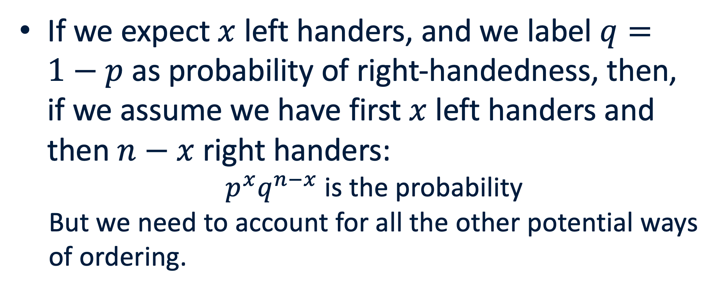
Binomial Distribution
If we expect $x$ left handers, and we label $q=1−p$ as probability of right-handedness, then, if we assume we have first $x$ left handers and then $n−x$ right handers:
$p^{x}q^{n−x}$ is the probability
But we need to account for all the other potential ways of ordering.

Slide 37
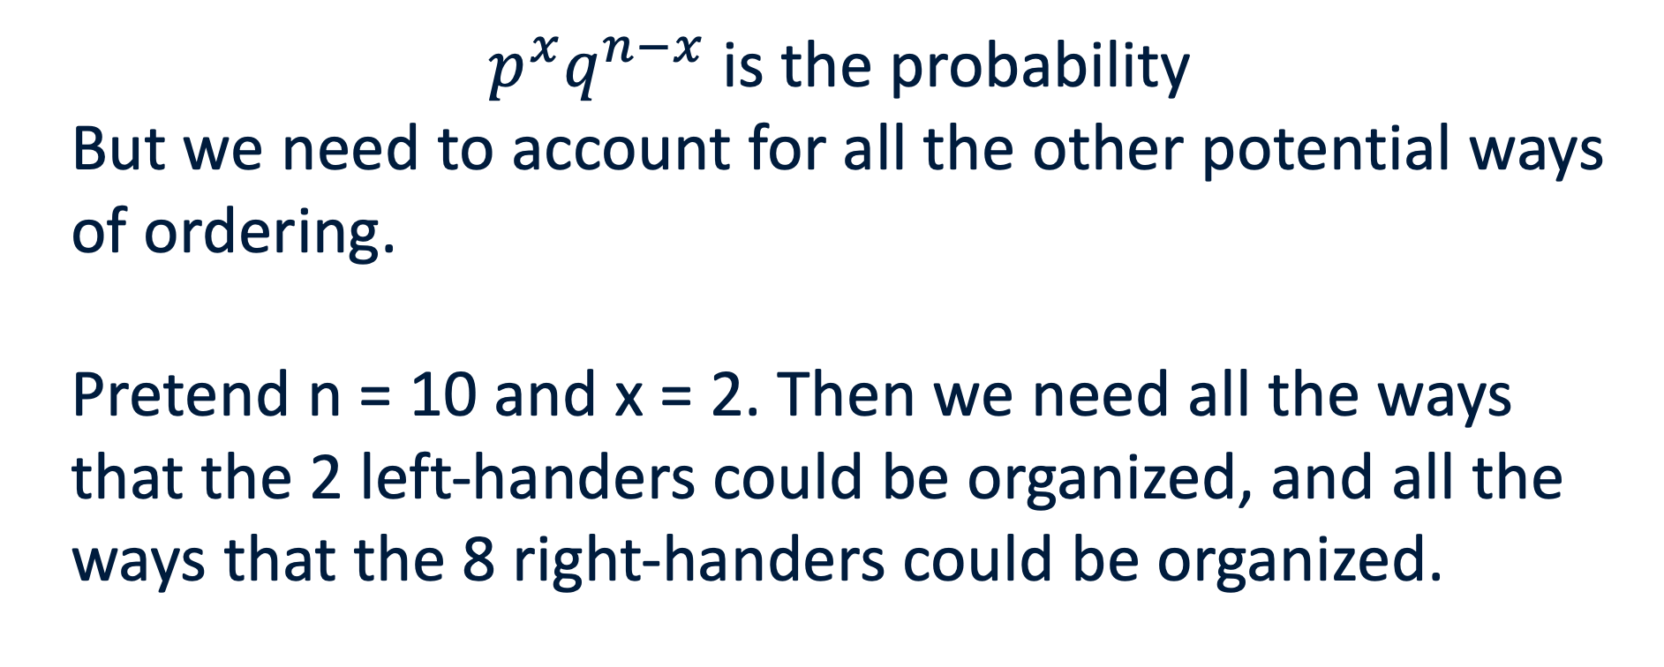
Binomial Distribution
$p^{x}q^{n−x}$ is the probability
But we need to account for all the other potential ways of ordering.
Pretend n = 10 and x = 2. Then we need all the ways that the 2 left-handers could be organized, and all the ways that the 8 right-handers could be organized.

Slide 38
Binomial Distribution
Pretend n = 10 and x = 2. Then we need all the ways that the 2 left-handers could be organized, and all the ways that the 8 right-handers could be organized.
Ways 10 people can be ordered = 10! = 10 * 9 * 8…
Ways 2 people can be ordered = 2! = 2*1
Ways 8 people can be ordered = 8!
We also need to consider that the 2 ways the left-handers organize interacts with the 8! ways that the right handers organize.

Slide 39
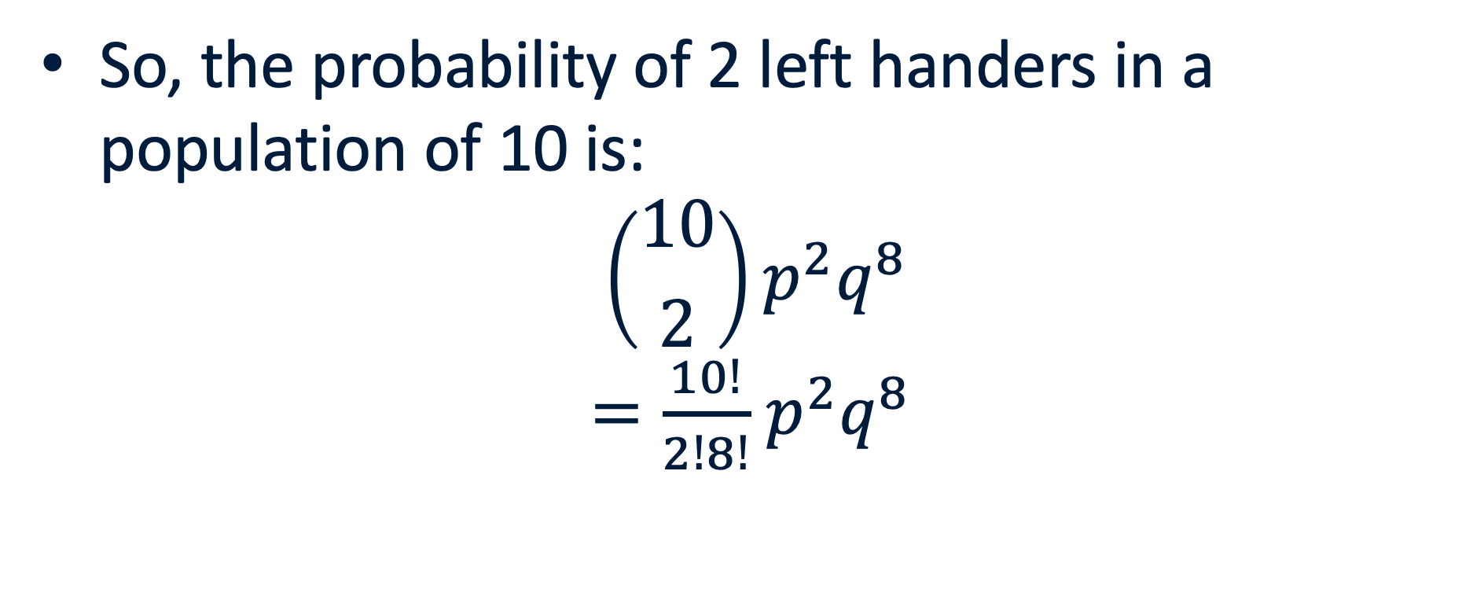
Binomial Distribution
So, the probability of 2 left handers in a population of 10 is:
$$\left({10 \atop 2}\right)p^{2}q^{8}$$
$=\frac{10!}{2!8!}$ $p^{2}q^{8}$

Slide 40
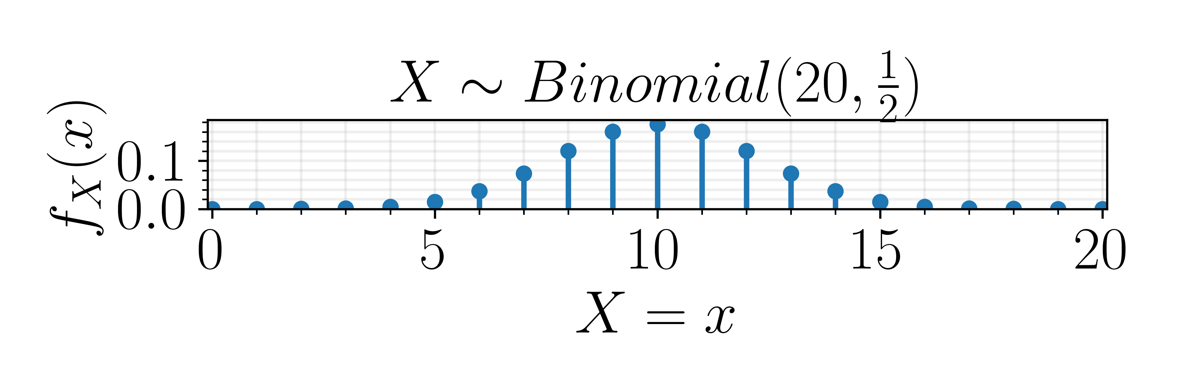
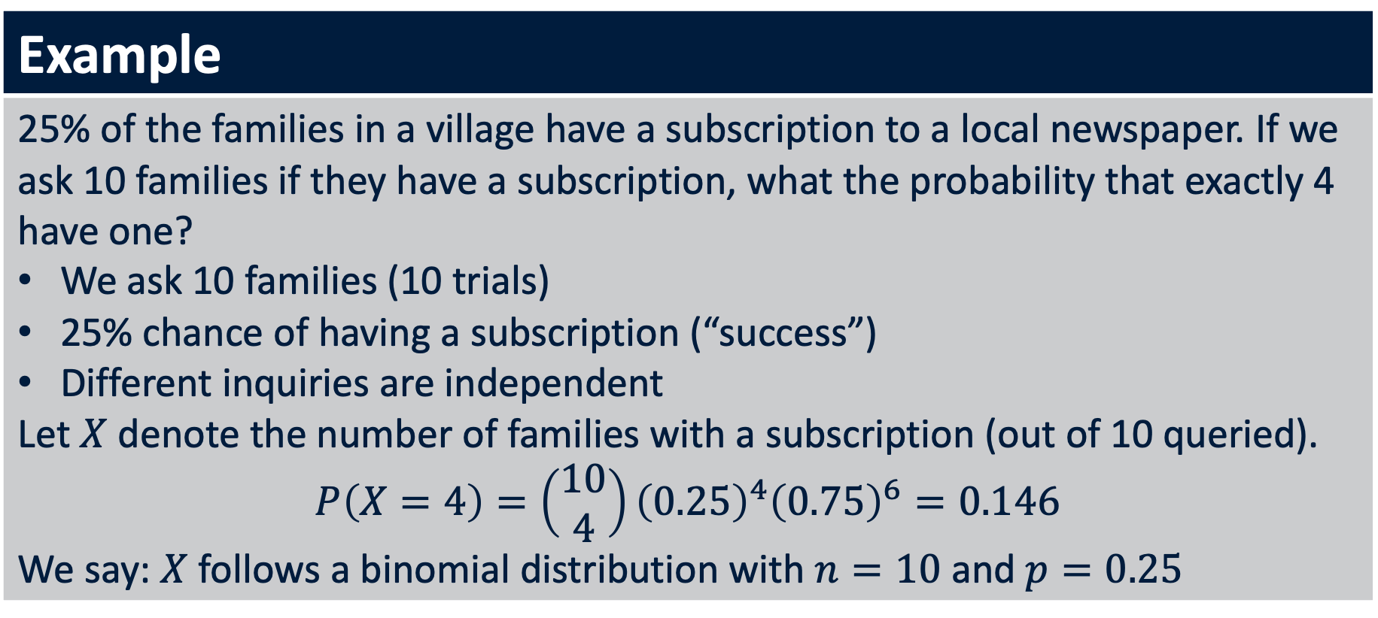
Binomial distribution
Example
25% of the families in a village have a subscription to a local newspaper. If we ask 10 families if they have a subscription, what the probability that exactly 4 have one? We ask 10 families (10 trials) 25% chance of having a subscription (“success”) Different inquiries are independent Let $X$ denote the number of families with a subscription (out of 10 queried). $$P\left(X=4\right)=\left(\begin{matrix}10 \\ 4\end{matrix}\right){\left(0.25\right)}^{4}{\left(0.75\right)}^{6}=0.146$$ We say: $X$ follows a binomial distribution with $n=10$ and $p=0.25$
Bernoulli process

Slide 41





Binomial distribution
Binomial distribution
If we do $n$ independent trials, where each time the success probability is $p∈\left[0,1\right]$, and we define $X$ to be the number of successes, then $X∼B\left(n,p\right)$, $$P\left(X=x\right)=\left(\begin{matrix}n \\ x\end{matrix}\right)p^{x}{\left(1−p\right)}^{n−x}, x=0,1,2,…, n$$
pick $x$ out of $n$
$x$ successes each w.p. $p$
$n−x$ failures each w.p. $1−p$
Descriptive statistics: $X∼B\left(n,p\right)$
$$E\left[X\right]=np$$ $$Var\left(X\right)=np\left(1−p\right)$$

Slide 42

Binomial Distribution
Probability
Notes:
Replace with seeing theory binomial

Slide 43
Mean of Binomial Distribution
Now if we wanted a margin of error on the mean, we need to know its sampling distribution. We could do this using bootstrapping: sampling with replacement and recalculating the statistic of interest.
But we can actually also do it using the sampling distribution.

Slide 44
Distributions of Summary Statistics
Every summary statistic when derived from the realizations of random variables has an associated distribution.
But why bother trying to figure this out when we can bootstrap all of it?
Bootstrap is harder with large datasets, larger models and sometimes you have variables where using a distribution is the better choice.

Slide 45

Mean of Binomial Distribution: Margin of Error
We can see how the distribution looks for different numbers of people in our survey.
As the number increases, the shape of the distribution seems to look like something we’ve seen before…
Notes:
What else is the margin of error called?

Slide 46
Law of large numbers
First step: Law of large numbers
The law of large numbers states that as your sample size n gets larger and larger, then the sample mean (the estimate) gets closer and closer to the population mean (the parameter).
You will have to wait for a proof of this.
But you’ve already seen it in action

Slide 47

Law of large numbers

Slide 48
Central Limit Theorem
The law of large numbers says that the sample mean converges to the population mean as the n increases.
We don’t know anything about the distribution of the sample mean… but it looks familiar.

Slide 49

Central Limit Theorem
Indeed, the central limit theorem proves that:
For distributions without very heavy tails, the sample mean converges to the normal [bell curve] distribution with the population mean as its mean (law of large numbers) and standard deviation = $σ/\sqrt{n}$ = population standard error!
The implications of this are huge!

Slide 50
Central Limit Theorem
We can always pretend remember than some datapoint is a random variable comes from a distribution.
The central limit theorem says that the mean of that random variable, WHATEVER it is, converges to the true population mean and a normal distribution.
The fact that this is true is incredible and spurred some poeticism from Francis Galton.

Slide 51

Central Limit Theorem
The law [central limit theorem] would have been personified by the Greeks and deified, if they had known of it. It reigns with serenity and in complete self-effacement, amidst the wildest confusion. The huger the mob, and the greater the apparent anarchy, the more perfect is its sway.
-- Francis Galton

Slide 52
Assumptions of CLT
All random variables are independent.
All random variables come from the same distribution.
The population variance of the random variable is finite and non-zero.

Slide 53

Why the normal distribution?
$$g\left(x\right)= \frac{1}{σ√2π }\exp{ (\frac{1}{2}\frac{{\left(x −μ\right)}^{2}}{σ^{2}})}$$
Turns out that when you have sums of random variables they lead to a symmetric distribution.
Sums of normally distribution R.V.s are normally distributed.
Since sums of random variables leads to a symmetric distribution and gaussian sums lead to gaussians, sums of any random variables give a normal.

Slide 54
Why the normal distribution?
See the following videos for more visual introductions to how the central limit theorem works and why a normal distribution:
https://www.youtube.com/watch?v=zeJD6dqJ5lo&t=0s
https://www.youtube.com/watch?v=d_qvLDhkg00

Slide 55
Central Limit Theorem
SO. What can we do with the central limit theorem?
Define the probability for the mean and through that a sense for uncertainty/margins or error!
Now that we know that the mean converges to the normal distribution, we can estimate the 95% range within which we expect the population parameter to fall!

Slide 56



Normal distribution
Normal Distribution
An RV $X$ has a normal distribution with parameters $μ$ and $σ$, $X∼N(μ,σ)$ if the density is given by $$f\left(x\right)=\frac{1}{σ\sqrt{2π}}e^{−\frac{1}{2}{\left(\frac{x−μ}{σ}\right)}^{2}}, if x∈ℝ$$
Descriptive statistics: $X∼N\left(μ,σ\right)$
$f$ is symmetric around and maximal for $X=μ$ $$E\left[X\right]=μ$$ $$Var\left(X\right)=σ^{2}$$

Slide 57


Normal distribution
Theorem: Standard Normal Distribution
If $X∼N(μ,σ)$ and $Z=\frac{X−μ}{σ}$, then $Z∼N(0,1)$ (called standard normal dist.) Proof: Let $\tilde{z}=\frac{\tilde{x}−μ}{σ}$. Then $P\left(X≤\tilde{x}\right)=P\left(\frac{X−μ}{σ}≤\frac{\tilde{x}−μ}{σ}\right)=P\left(Z≤\tilde{z}\right)$. But then $$F\left(\tilde{z}\right)=P\left(Z≤\tilde{z}\right)=P\left(X≤\tilde{x}\right)=F\left(\tilde{x}\right)$$ $$=\frac{1}{σ\sqrt{2π}}\int_{−∞}^{\tilde{x}}{e^{−\frac{1}{2}{\left(\frac{x−μ}{σ}\right)}^{2}}dx}=\frac{1}{\sqrt{2π}}\int_{−∞}^{\tilde{z}}{e^{−\frac{1}{2}z^{2}}dz}$$ Which means that $f\left(\tilde{z}\right)=\frac{1}{\sqrt{2π}}e^{−\frac{1}{2}{\tilde{z}}^{2}}$, so $Z∼N(0,1)$ $∎$
$$z=\frac{x−μ}{σ},dz=\frac{1}{σ}dx$$
Notes:
This is the first time we are seeing a function of a random variable. Now functions of random variables don’t work like functions of traditional variables. So we can’t just plug in a distribution into the function to get the new distribution out. Instead we have to think about it through the cumulative distribution.

Slide 58
Confidence Interval
If we can calculate the sampling distribution for the mean, then we can assess the probability of different values for the population parameter.
How best to characterize this distribution?

Slide 59
Confidence Interval
Brings us back to quantifying uncertainty.
Since sampling distribution for a mean under CLT is a symmetric distribution, the standard deviation is a great measure to use.
Also, we know based on the standard normal what amount of standard deviations gives us 95% of possible values.

Slide 60

Standard Normal Distribution
Every normal distribution can be transformed into the standard normal.
How? Simple variable substitution.
$Z=\frac{X −μ}{σ}$ , $Z\sim N(0, 1)$
This means for any random variable distributed as $N\left(μ, σ\right)$, if we wanted the probability for a range $[x_{1}, x_{2}]$, we can use P([$\frac{x_{1} −μ}{σ}$, $\frac{x_{2} −μ}{σ}$]) under a standard normal.

Slide 61

Confidence Limits

Slide 62

Sampling Distribution for a Mean
Assuming central limit theorem holds: $\overline{x} \sim N\left(μ ,\frac{σ}{\sqrt{n}}\right), \frac{σ}{\sqrt{n}} called Standard Error$
If we want the range within which, 95 times out of a 100, our sample mean will cover the population mean, we calculate: $\overline{x} ±1.96 ∗STD_{\overline{x}}=[\overline{x}−1.96 ∗ \frac{σ}{\sqrt{n}}$ , $\overline{x}+1.96 ∗ \frac{σ}{\sqrt{n}}$ ]

Slide 63

Central Limit Theorem
States that a sample mean for random variables from almost any distribution converges to the normal distribution.
That is, regardless of distribution of random variable:
$$\lim_{n→ ∞}{\overline{x}\sim N(μ ,\frac{σ}{\sqrt{n}})}$$

Slide 64



Confidence Intervals for a Single Mean
Say we had a set of brain weights for babies.

Slide 65

Confidence Intervals for a Single Mean
We can estimate the confidence intervals for the sample mean by calculating the standard error.
Standard error = $\hat{σ}/\sqrt{n}$
95% confidence intervals are: $\overline{x} ±1.96∗$ $\hat{σ}/\sqrt{n}$
$z=\frac{x−μ}{σ}$ is called a z-score. For example, z = 1.96 for a probability of 0.95.

Slide 66

Confidence Intervals for a Single Mean
95% confidence intervals are: $\overline{x} ±1.96∗$ $\hat{σ}/\sqrt{n}$
Where does the 1.96 come from?
The Central Limit Theorem allowing us to assume a normal distribution for the sample mean!
Under the normal, 1.96 standard errors = 95% probability. 1.96 is referred to as $z_{\frac{α}{2}}$ for $α=0.05$.

Slide 67

Confidence Intervals for a Single Mean

Slide 68

Sampling Distribution for a Mean

Slide 69
Sampling Distribution for a Mean

Slide 70
Sampling Distribution for a Mean

Slide 71
Sampling Distribution for a Mean

Slide 72

Confidence Intervals for Small Datasets
Say we want to get the margin of error for the sample mean.
We will still rely on the standard error: $se=\frac{std}{\sqrt{n}}$
$Mean \overline{x} ±\left(something\right)∗se$
Before the something was $z_{\frac{α}{2}}$ = 1.96 ($α=$ 0.05)

Slide 73


Confidence Intervals for Small Datasets
Number of hours watching television in USA
Standard Error = $\frac{s}{\sqrt{n}}=\frac{2.66}{\sqrt{1324}}=0.0731$
95% confidence interval = [2.84, 3.12] hours
Large sample size – more confidence in mean.

Slide 74

Confidence Intervals for Small Datasets
For big datasets, we can assume the mean is close to a normal distribution and use standard error.
For small datasets, this is unlikely.
Let’s say we can at least assume the $X$ is normally distributed.

Slide 75

Confidence Intervals for Small Datasets
When trying to estimate the standard error for a small dataset, we need to estimate the standard deviation, which can have more error (farther from population parameter) as a result.
To make up for this, rather than use a z-score $(z_{\frac{α}{2}})$ we instead use a t-score that comes from a bell-like distribution with thicker tails.

Slide 76
t-Distribution
When trying to estimate the standard error for a small dataset, we need to estimate the standard deviation, which can have more error (farther from population parameter) as a result.
To make up for this, rather than use a z-score $(z_{\frac{α}{2}})$ we instead use a t-score that comes from a bell-like distribution with thicker tails.

Slide 77

t-Distribution Definition
t-Distribution
t- Distribution is bell-shaped and for a mean of 0, is symmetric about 0. Probability depends on the number of samples which guides the degrees of freedom (df = samples -1) of the distribution. Has thicker tails and more variability as a result than the normal. Can get a better sense for confidence in smaller samples, that is, we can be more sure our sample parameter estimate and interval captures the population parameter estimate using the $t−score$ multiplied by the standard error.

Slide 78


t-Distribution Definition
t-Distribution
The Probability distribution function is incredibly complicated so we’ll focus on how the distribution looks at different numbers of samples (=df+1). Once the number of samples > 30 then the t-distribution is indistinguishable from the normal.
DF = 6

Slide 79



t-Distribution
Small scale stock market activity.
What is the confidence interval for Monday?
$t_{\frac{0.05}{2}}^{10}=2.228$
Notes:
11.541 or (40.27, 63.37)

Slide 80

Is it fair to assume a Normal distribution?
Notes:
12 draws from a standard normal 100 times.

Slide 81
Is it fair to assume a normal distribution?
Using the t-distribution is actually robust.
(1) you can’t tell if you have a normal distribution when you have small samples and
(2) even if it isn’t, the t-Dist. gives confidence intervals that tends to capture the population.
Robust Statistical Method
﻿A statistical method is said to be robust with respect to a particular assumption if it performs adequately even when that assumption is modestly violated.
Notes:
A big problem in statistics in assumptions which is why its great to have in your toolbox ways to not make assumptions when analyzing data.

Slide 82
When doesn’t the t-distribution work?
Data aren’t independently generated.
Data has some extreme outliers.

Slide 83





Confidence Interval for Proportion of a Single Sample
If $n$ is large and $\hat{p}$is not too close to 0 or 1 ($n\hat{p}, n\left(1−\hat{p}\right)>5$), then
$σ$is estimated accurately by $\hat{p} (1−\hat{p})$.
The sampling distribution of $p$ can be approximated with a normal distribution ($\hat{p}$ is treated a$s a classical mean)$
$$\hat{p}$$
$p$
0.2
0.4
0.6
0.8
Proportion of Happy Customers
$$P\left(p∈[\hat{p}±z_{α/2} \sqrt{\frac{\hat{p}\left(1−\hat{p}\right)}{n}}]\right)≈1−α$$

Slide 84

Confidence Interval for Proportion of a Single Sample
If in an exit poll we see that 53.8 % of 3889 people voted for one candidate then we get:
$SD=\frac{\sqrt{\hat{p}}\left(1−\hat{p}\right)}{n} =\frac{\sqrt{0.538}∗√0.462}{3889}$ = 0.008 ~0.01
Suggests that CI is 51.6 to 55.8% for $α=0.05$.
$$\hat{p}$$
$p$
0.2
0.4
0.6
0.8
Proportion of Happy Customers
$$P\left(p∈[\hat{p}±z_{α/2} \sqrt{\frac{\hat{p}\left(1−\hat{p}\right)}{n}}]\right)≈1−α$$

Slide 85

Sample Size Needed
The general formula of $\hat{p} ±1.96∗se$ applied when you have large random samples.
For proportions this means you have at least 15 successes AND 15 failures.
Most cases, this is easily satisfied, when it isn’t you can always use bootstrapping.

Slide 86

Confidence Interval for a Poisson
$Mean ±1.96∗se$
Now if we knew that there were 497 homicides in one year (note that we are changing the bin size from days), and 557 the following year, can we judge if 557 is outside 95% CI?

Slide 87

Confidence Interval for a Poisson
For Poisson, we know the mean and variance are the same.
So if we say, we are estimating the rate from one year = 497/year.
Then the variance = 497.
Standard deviation = Standard error (why?) = $\sqrt{497}$ = 43.7
So is 557 outside 95% CI?
Notes:
453.3 to 540.7
Of course, with more data points we can judge more carefully whether the mean is accurate and get a better estimate for the standard error as well.

Slide 88

Confidence intervals

Slide 89
How much should we trust confidence intervals?
Confidence intervals for the speed of light in the early 19th century did NOT cover the population parameter we now know.
So why was that? Well confidence intervals cover the following case of quantifying measurement uncertainty:
Type A uncertainty: Uncertainty that reduces with more samples. But does nothing for:
Type B uncertainty: Systematic errors that have to do with the nature of measurement itself.

